Slide 1
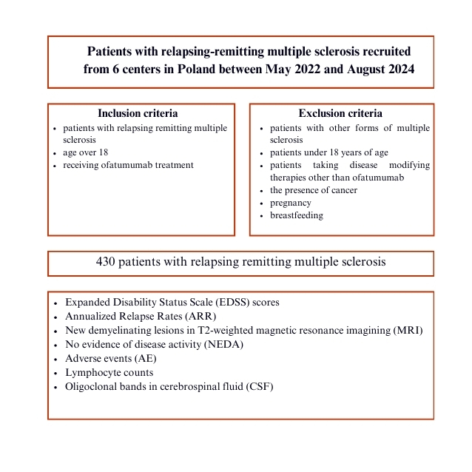

Early treatment with ofatumumab increases the likelihood of stabilizing disease in patients with relapsing-remitting multiple sclerosis
DOI: 10.5114/aoms/205112
Arch Med Sci 2026;22(2):834-840
Notes:
Introduction
Methods of multiple sclerosis (MS) treatment are evolving rapidly, with numerous classes of disease-modifying therapies (DMTs). A more aggressive approach to early and effective treatment of MS with a defined treatment target increases the chance of achieving a state of no evidence of disease activity (NEDA). Currently, B cell-depleting monoclonal antibodies have been proven as a highly effective strategy for the treatment of relapsing-remitting MS (RRMS). Ofatumumab (OFA), an anti-CD-20 monoclonal antibody, is effective in treatment of RRMS, as it positively affects relapse rates, magnetic resonance imaging (MRI) measures of disease activity, and disability progression.
Material and methods
A retrospective observational study was conducted in six MS clinical centers in Poland, including a cohort of patients with RRMS treated with OFA over a 2-year period.
Results
The results of this study showed a statistically significant decrease in the relapse activity of the disease in the course of a year of OFA therapy. The percentage of patients free of relapses increased from 45% before treatment to 88% after 1 year of follow-up. Moreover, the disability assessment index measured by the Expanded Disability Status Scale (EDSS) remained stable after 2 years of follow-up.
Conclusions
In the present study, the high efficacy of OFA therapy in reducing recurrent disease activity, as well as in inhibiting disability progression, with a favorable safety profile, was confirmed. Moreover, it was emphasized that to achieve the best possible inhibition of disease activity and its progression, it is necessary to implement the treatment as soon as possible after the diagnosis.

