Slide 1
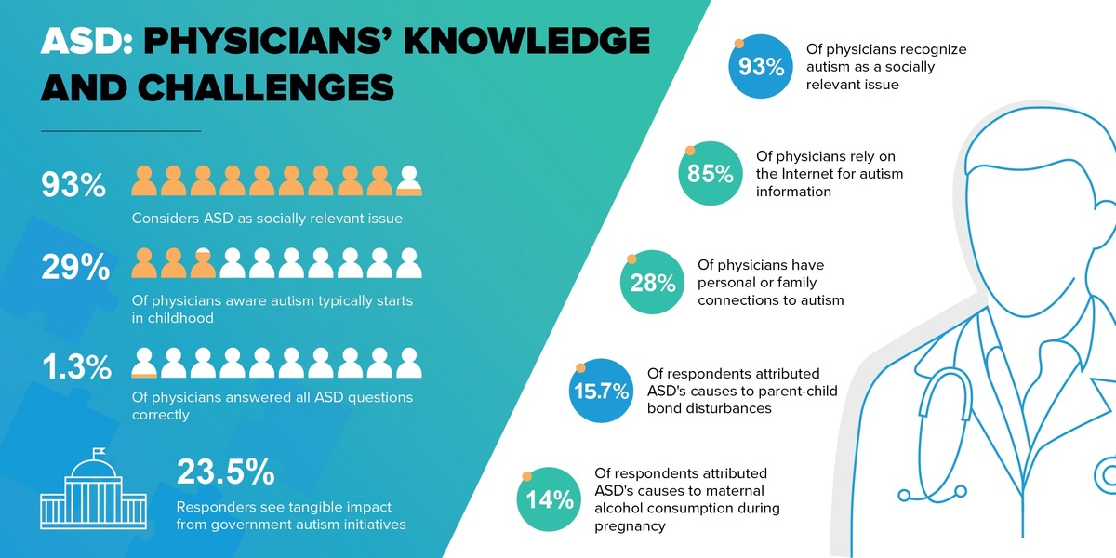

Evaluating physician knowledge of autism spectrum disorder: addressing diagnostic challenges, comorbidities, and the need for targeted education
DOI: 10.5114/aoms/205165
Arch Med Sci 2026;22(1):241-249
Notes:
Introduction
Autism spectrum disorder (ASD) is a complex neurodevelopmental condition with diverse symptoms and frequent comorbidities, posing diagnostic challenges. Despite advances in ASD awareness and diagnostic methods, significant knowledge gaps persist among healthcare professionals. This study assessed physicians’ knowledge of ASD, focusing on symptoms, comorbidities, and diagnostic challenges to enhance patient care.
Material and methods
This study, conducted in 2024, involved physicians attending courses at the Center of Postgraduate Medical Education in Warsaw (CMKP). Participation was anonymous and voluntary. Respondents completed the author’s own questionnaire and the Knowledge about Childhood Autism among Health Workers (KCAHW) questionnaire to assess autism knowledge across four domains: social interaction impairments, communication issues, obsessive behaviors, and disorder onset and comorbidities. Physicians also provided professional and demographic data.
Results
The study included 395 physicians, primarily young (mean age: 31), female (75%), and in early career stages, with most having up to five years of experience. While 75% had some contact with individuals on the autism spectrum, only 28% had close family or acquaintances with ASD. Knowledge about autism was moderate, averaging 74% correct responses, with higher accuracy in recognizing social interaction impairments (80%) and repetitive behaviors (78.5%), but lower accuracy regarding comorbidities (63%). Younger, less experienced physicians, women, and those with personal ASD contact had higher knowledge about autism.
Conclusions
The study highlights the need for targeted ASD education to address specific knowledge gaps among healthcare professionals, essential for providing informed and compassionate care.

