Slide 1
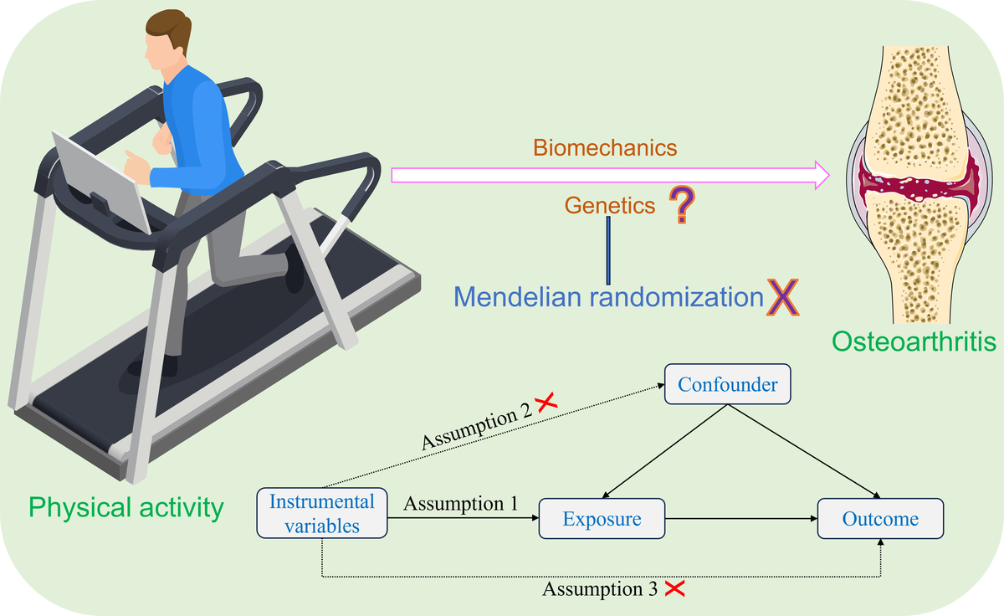

Genetic causal relationship between physical activity and osteoarthritis: a two-sample Mendelian randomization study
DOI: 10.5114/aoms/205242
Arch Med Sci 2025;21(5):1713-1721
Notes:
Introduction
Appropriate levels of physical activity (PA) can help prevent osteoarthritis (OA) and alleviate its symptoms. However, excessive or prolonged PA has been identified as a potential risk factor for OA. Despite these observations, the genetic causal relationship between PA and OA remains unclear. Therefore, this study aimed to clarify the causal link between PA and OA by investigating their shared genetic factors.
Material and methods
The study utilized genome-wide association study (GWAS) summary data to investigate the relationship between three types of PA – moderate to vigorous physical activity (MVPA), vigorous physical activity (VPA) and strenuous sports or other exercises (SSOE) – and knee osteoarthritis (KOA). A two-sample Mendelian randomization (MR) analysis was conducted using the TwoSampleMR and MRPRESSO packages in R. Sensitivity analyses were performed. Cochran’s Q statistic and Rucker’s Q statistic were employed to assess heterogeneity. The MR-Egger intercept test was used to evaluate horizontal pleiotropy. Additionally, the MR pleiotropy residual sum and outlier (MR-PRESSO) method was applied to detect horizontal pleiotropy and identify outlier SNPs. A leave-one-out analysis was conducted to determine whether the genetic associations were influenced by any single nucleotide polymorphism (SNP). The MR robust adjusted profile score (MR-RAPS) method was further used to validate the normal distribution of the MR analysis.
Results
The results of the MR analysis indicate that MVPA (p = 0.436, odds ratio [OR] = 1.814, 95% confidence interval [CI] [0.405–8.119]), VPA (p = 0.995, OR = 1.011, 95% CI [0.040–25.224]) and SSOE (p = 0.266, OR = 0.258, 95% CI [0.024–2.812]) have no significant genetic causal relationship with KOA. We did not detect any heterogeneity or horizontal pleiotropy (p > 0.05), nor were there any outliers in our MR analysis. Our MR results were not driven by a single SNP and were normally distributed (p > 0.05).
Conclusions
The results of this study provide evidence against a genetic causal relationship between PA and KOA, thereby contributing to the understanding of their correlation. However, the study does not rule out the possibility of a relationship through non-genetic mechanisms.

