Slide 1
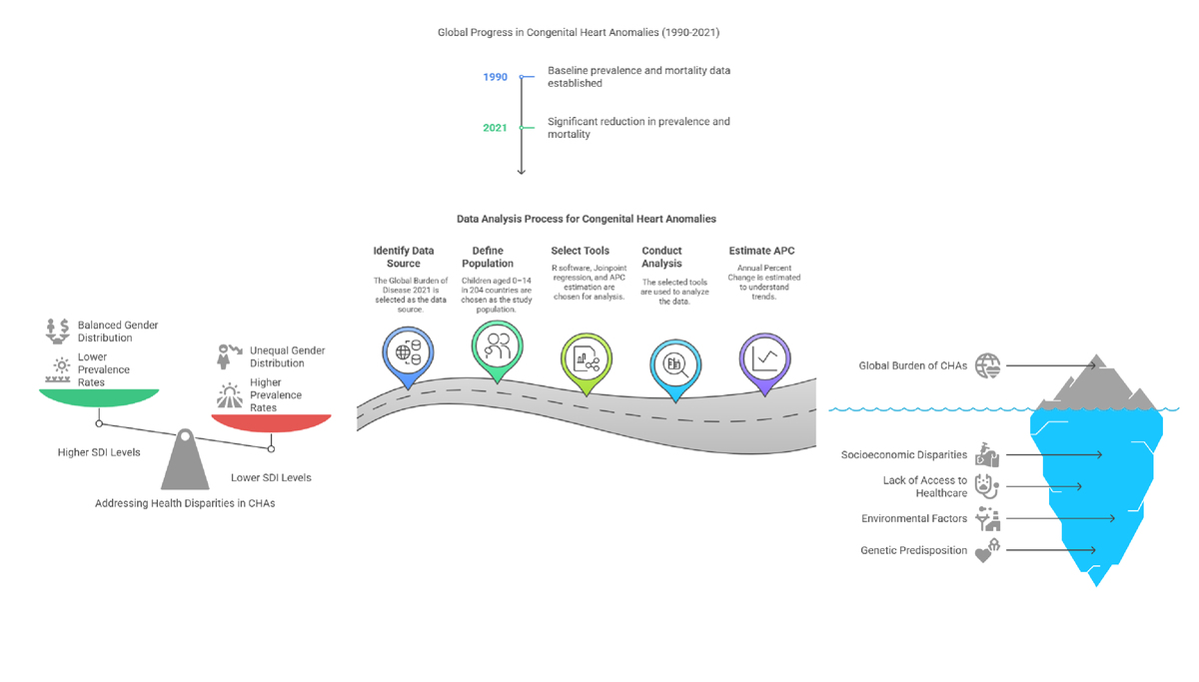

Evolving global patterns of congenital heart anomalies from 1990 to 2021
DOI: 10.5114/aoms/205265
Arch Med Sci 2025;21(4):1201-1212
Notes:
Introduction
Congenital heart anomalies (CHAs) remain a significant global health issue for children, evidenced by persistent disparities in healthcare access across different socio-demographic index (SDI) regions and genders, despite slight decreases in prevalence.
Material and methods
This cross-sectional study used the Global Burden of Disease 2021 dataset to analyze CHAs in children aged 0–14 from 204 countries. Data analysis was performed using R software, incorporating global mapping, Joinpoint regression, and estimation of annual percent changes and rates, stratified by age, sex, and SDI.
Results
A total of 218,909,652 children, including 113,892,505 (52.03%) males and 105,017,147 (47.97%) females, were included in the analysis. From 1990 to 2021, the global prevalence of CHAs in children decreased by 4.294% (95% uncertainty interval [UI], –5.696–2.695%). Over three decades, CHA-associated deaths decreased from 497,979 (95% UI: 282,166–642,052) to 222,415 (95% UI: 181,359–275,182). The global mortality rate decreased from 28.633 (95% UI: 16.224–36.918) to 11.055 (95% UI: 9.014–13.678) per 100,000 population, while the prevalence rate changed from 377.257 cases per 100,000 in 1990 to 361.060 cases per 100,000 in 2021. Among the five SDI regions, the low SDI region had the highest CHA-associated mortality rate in 2021.
Conclusions
The study highlights the persistent global challenge of CHAs, particularly in low-SDI regions. It underscores the need for targeted public health interventions to reduce disparities and improve health outcomes globally.

