Slide 1
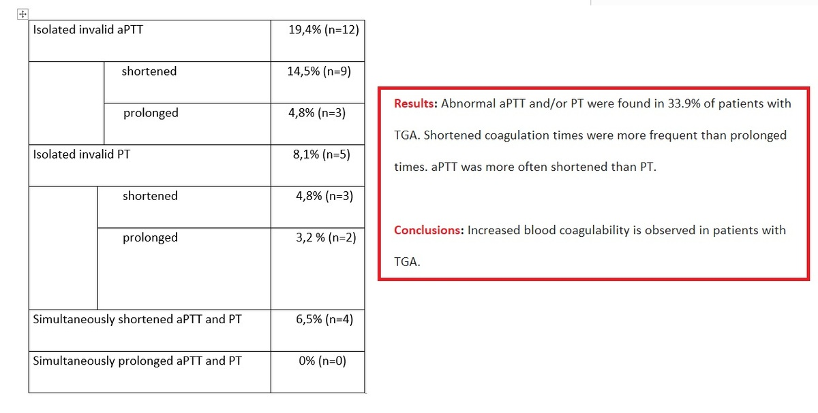

Blood coagulation disorders associated with transient global amnesia (TGA): a cause or consequence?
DOI: 10.5114/aoms/205327
Arch Med Sci 2025;21(3):1077-1079
Notes:
Introduction
Material and methods
Results
Conclusions

