Slide 1
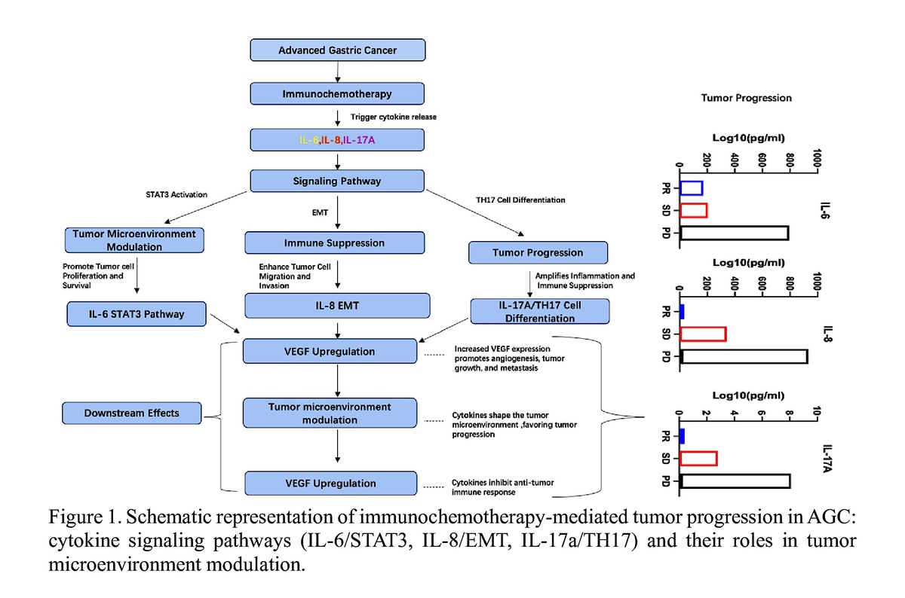

IL-6, IL-8, and IL-17A as predictive biomarkers for treatment response to PD-1 blockade immunochemotherapy in advanced gastric cancer
DOI: 10.5114/aoms/205520
Arch Med Sci 2026;22(3):1510-1527
Notes:
Introduction
Advanced gastric cancer (AGC) treatment outcomes are improved with PD-1 blockade immunochemotherapy, but predicting responders remains challenging. Cytokines, key immune response regulators, may predict treatment outcomes. The aim of the study was to identify cytokines as predictive biomarkers for PD-1 inhibitor-based cancer immunotherapy response in AGC, improving treatment decision-making.
Material and methods
In this retrospective analysis, 241 patients with AGC were included, with 136 patients receiving an immunochemotherapy regimen that included PD-1 blockade, while 105 patients constituted the control group receiving chemotherapy alone. Serum levels of various cytokines (IL-2, IL-4, IL-5, IL-6, IL-8, IL-10, IL-1β, IL-17A, IFN-α2, IFN-γ, TNF-α and IL-12p70) were measured using a Luminex assay after the initiation of treatment.
Results
Patients undergoing PD-1 blockade immunochemotherapy showed significantly elevated levels of IL-6, IL-8, and IL-17A, especially within the group that exhibited a therapeutic response, compared to the control group. Notably, among those who responded to the immunochemotherapy, there was a marked reduction in the concentrations of IL-6, IL-8, and IL-17A over the course of the treatment. In contrast, such reductions were not observed in the non-response group. Among the assessed cytokines, the combined evaluation of IL-6, IL-8, and IL-17A, in conjunction with CA-125, demonstrated the highest predictive accuracy for assessing the efficacy of immunochemotherapy in AGC patients.
Conclusions
Our study identified IL-6, IL-8, and IL-17A cytokines as predictive biomarkers for treatment outcomes in AGC patients receiving immunochemotherapy. Combining these cytokines with CA-125 significantly enhances predictive accuracy, enabling tailored treatment strategies to improve patient outcomes.

