Slide 1
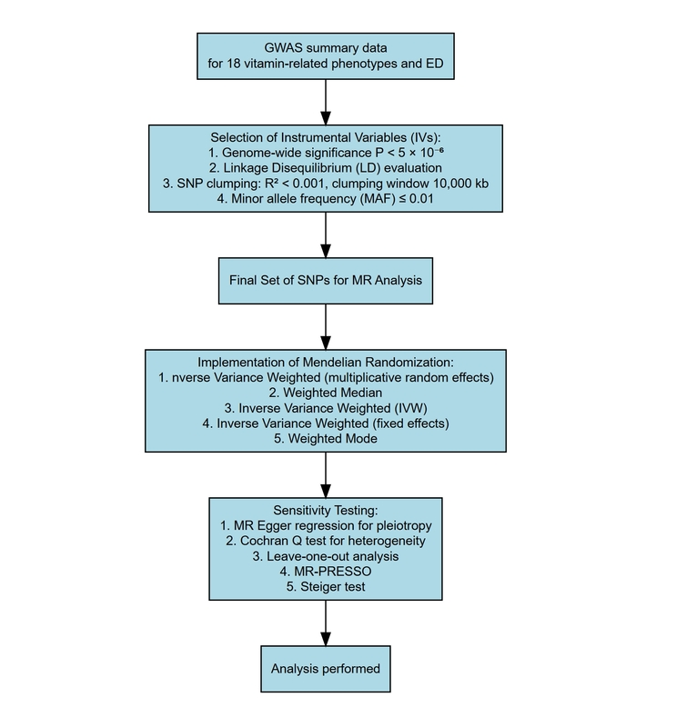

Causal relationship between carotene levels and male erectile dysfunction: a sex-stratified Mendelian randomization study
DOI: 10.5114/aoms/205546
Arch Med Sci 2025;21(3):1069-1072
Notes:
Introduction
Material and methods
Results
Conclusions

