Slide 1
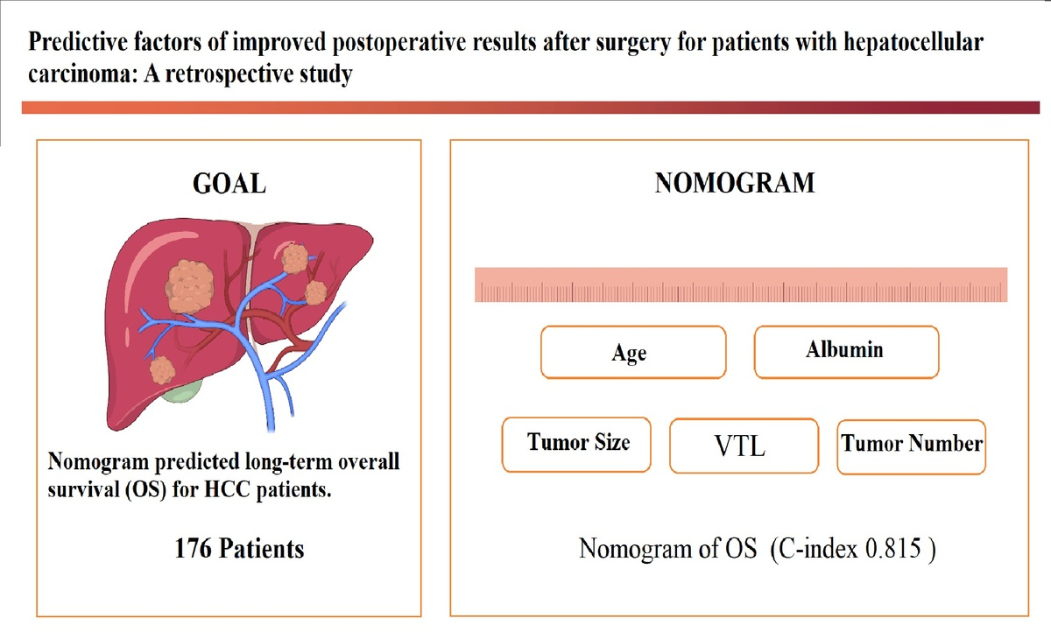

Predictive factors of improved postoperative results after surgery for patients with hepatocellular carcinoma: a retrospective study
DOI: 10.5114/aoms/205596
Arch Med Sci 2026;22(3):1482-1497
Notes:
Introduction
Several clinical studies have demonstrated the benefits of surgery for patients with hepatocellular carcinoma (HCC). The goal of our study was to identify prognostic factors associated with overall survival (OS) and recurrence-free survival (RFS) in patients with HCC and develop nomograms to predict these factors.
Material and methods
We retrospectively conducted follow-up evaluations of 176 patients with HCC up to 10 years after their tumors were removed. All of these patients were from a single hospital, and all of the enrolled patients were divided into two groups: those who survived less than 3 years and those who survived more than 3 years. Independent prognostic factors associated with OS and RFS were determined via univariate and multivariate Cox regression model analyses. Two prognostic nomogram models were built on the basis of the data and evaluated via the concordance index (C-index). The calibration curves indicated that the two nomograms performed well over a 5-year period. Additionally, the area under the receiver operating characteristic (ROC) curve and the time-dependent area under the ROC curve (AUC) were determined, and decision curve analyses (DCAs) were conducted.
Results
The nomograms successfully discriminated patients with HCC. Prognostic factors for OS and RFS were identified, and nomograms were successfully built. The calibration discrimination was good for both the OS and RFS nomogram prediction models (C-indexes: 0.815 and 0.80, respectively). Our nomograms and calibration curves demonstrated favorable results with strong predictive accuracy and ROC curves, and according to the DCA, our nomogram results showed a greater net clinical benefit. The Kaplan-Meier plots for OS and RFS were generated via the log-rank test, the p-value of which was < 0.001. Ultimately, the nomograms successfully discriminated patients with HCC.
Conclusions
We established nomogram survival prediction models to predict the prognosis of HCC after invasive treatment and achieved an acceptable level of accuracy in both OS and RFS analyses. These models may be valuable for guiding the selection of clinical treatment strategies and may also facilitate clinical decision making.

