Slide 1
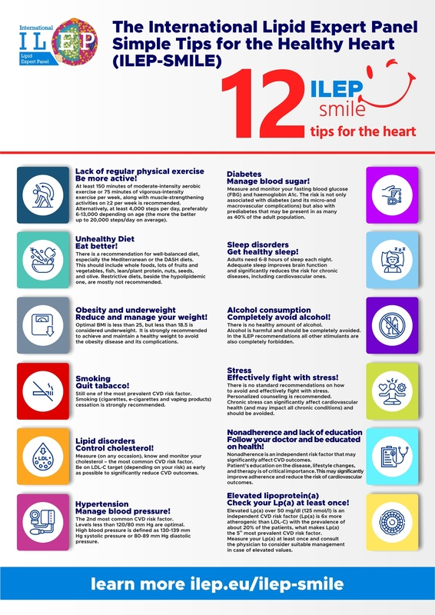

A 360° perspective on cardiovascular prevention: the International Lipid Expert Panel SiMple tIps for the heaLthy hEart (ILEP-SMILE)
DOI: 10.5114/aoms/205732
Arch Med Sci 2025;21(3):711-718
Notes:
Cardiovascular disease (CVD), particularly atherosclerotic cardiovascular disease (ASCVD), is the most common cause of death worldwide. Despite decades of research into lifestyle factors and medications, we still cannot effectively prevent the occurrence of ASCVD or the many incident CVD events and their complications. Yet, in most countries, only a small percentage of the healthcare budget is allocated to (primary) prevention, and only a few nations have introduced effective integrated (coordinated) programmes in primary prevention to promote health education, invest in health as early as possible, and prevent adverse CVD events. The International Lipid Expert Panel SiMple tIps for the heaLthy hEart (ILEP-SMILE) responds to this significant ineffectiveness by offering the most comprehensive population approach, including early, effective education, improvement of all recognised risk factors, alongside those that remain frequently unmeasured, such as lipoprotein(a), factors which are often overlooked such as sleep disturbances and alcohol consumption, and the challenging aspect of stress, and its effect on cardiovascular health. Finally, ILEP-SMILE places considerable emphasis on adherence as a result of education; without it, even efficient lifestyle changes and the most innovative drugs may not yield the expected outcomes. This is also a loud call to action and international collaboration to jointly address the lifetime burden of cardiovascular disease.

