Slide 1
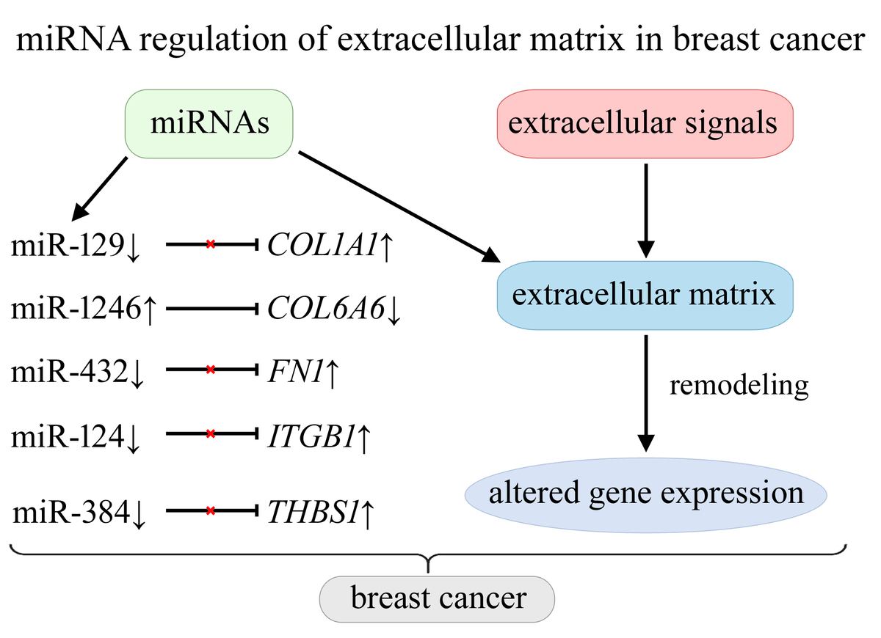

miRNA-mediated regulation of extracellular matrix dynamics across breast cancer subtypes
DOI: 10.5114/aoms/205734
Notes:
Introduction
Interactions between extracellular signals and the extracellular matrix (ECM) influence cellular phenotype and molecular functions, affecting proliferation, differentiation, adhesion, apoptosis, and migration. Deregulation of ECM remodeling contributes to the development of diseases, including breast cancer. The study was aimed to identify microRNAs (miRNAs) that may regulate the activity of genes involved in ECM remodeling and focal adhesion across five breast cancer subtypes in Polish women.
Material and methods
The study enrolled patients representing five breast cancer subtypes: 130 luminal A, 100 HER2-negative luminal B, 96 HER2-positive luminal B, 36 non-luminal HER2-positive, 43 triple-negative breast cancer (TNBC) cases. Cancer tissue samples were collected during surgery along with healthy tissue margins (control group). The expression profiles of genes associated with ECM remodeling and focal adhesion were evaluated with mRNA microarrays and reverse transcription quantitative polymerase chain reaction (RT-qPCR). Protein expression was assessed using enzyme-linked immunosorbent assay (ELISA). miRNA detection and target prediction were performed using miRNA microarrays.
Results
Overexpression of COL1A1, FN1, ITGB1, and THBS1 may be associated with reduced levels of miR-129, miR-432, miR-124, and miR-384, respectively. Decreased COL6A6 expression may result from increased activity of miR-1246. Additionally, the study revealed increased levels of COL1A2, COMP, and SPP1 with reduced activity of RELN, across all five breast cancer subtypes.
Conclusions
This is the first study to comprehensively analyze miRNA-mediated regulation of ECM-related genes across five breast cancer subtypes in a Polish cohort. Overexpression of COL1A1, FN1, and ITGB1 is linked to reduced levels of specific miRNAs, while decreased COL6A6 expression is associated with increased miR-1246 activity.

