Slide 1
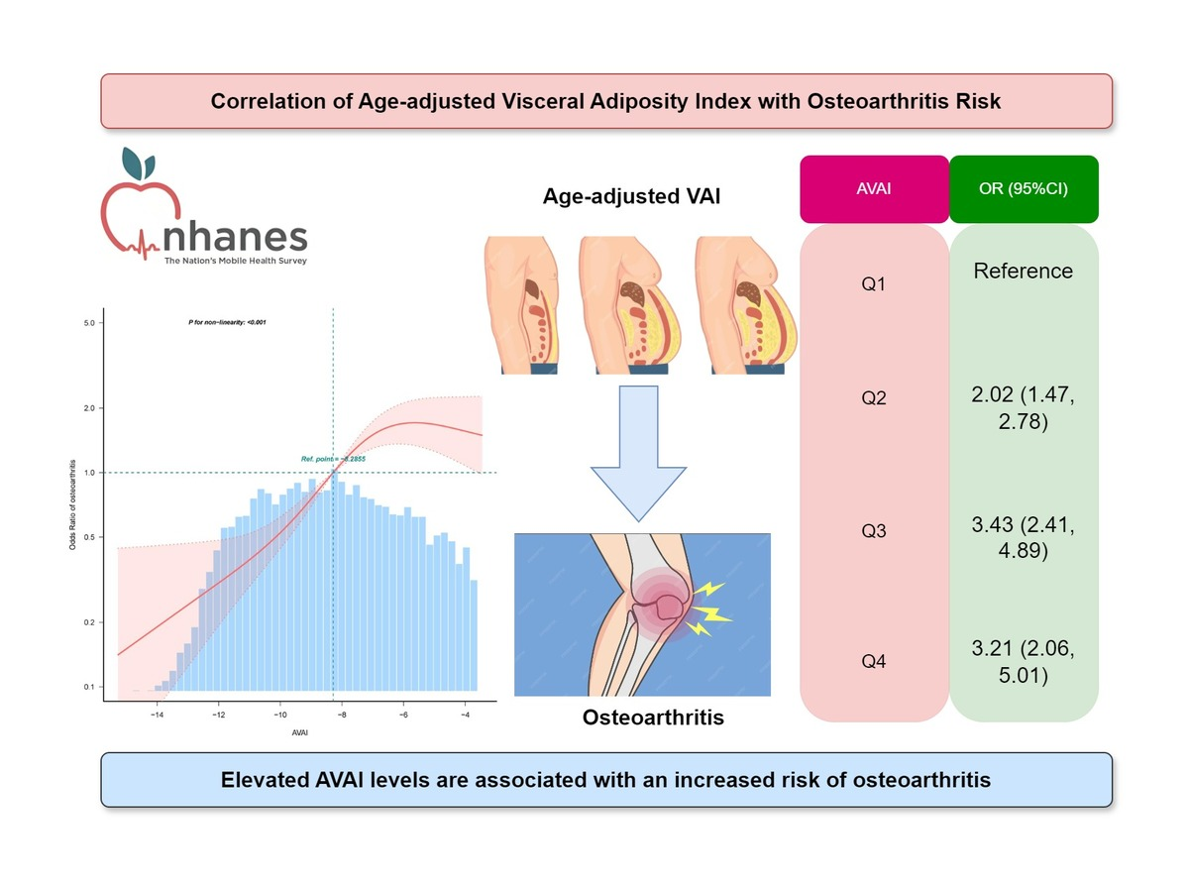

Correlation of age-adjusted visceral adiposity index with osteoarthritis risk: a cross-sectional study from NHANES 1999–2018
DOI: 10.5114/aoms/205735
Arch Med Sci 2025;21(5):1907-1915
Notes:
Introduction
Obesity and aging are established independent risk factors for osteoarthritis (OA). This study aimed to evaluate the correlation between the age-adjusted visceral adiposity index (AVAI) and OA.
Material and methods
This cross-sectional study utilized data from the National Health and Nutrition Examination Survey (NHANES) collected between 1999 and 2018. The correlation between AVAI and prevalence of OA was explored through receiver operating characteristic (ROC) regression, multivariate logistic regression, restricted cubic spline regression, and subgroup analysis.
Results
The study cohort comprised 20,628 participants, of whom 2,297 (11.1%) were diagnosed with OA. An increase in the quartile range of AVAI was correlated with a significant rise in the prevalence of OA (1.5% vs. 5.1% vs. 14.4% vs. 23.6%, p < 0.001). Logistic regression analysis demonstrated a significant positive correlation between AVAI and the risk of OA (OR = 1.14, 95% CI: 1.06, 1.23). Subgroup analyses indicated that this correlation was more pronounced in individuals aged over 60 years and those with diabetes. RCS regression analysis further identified a non-linear positive correlation, with an inflection point at –6.03. Finally, the area under the ROC curve (AUC) for AVAI was notably greater (AUC = 0.757, 95% CI: 0.747, 0.766) compared to traditional obesity indices.
Conclusions
This study is the first to demonstrate a significant positive correlation between the prevalence of OA and AVAI, with AVAI exhibiting superior diagnostic performance over traditional obesity indices in identifying OA.

