Slide 1
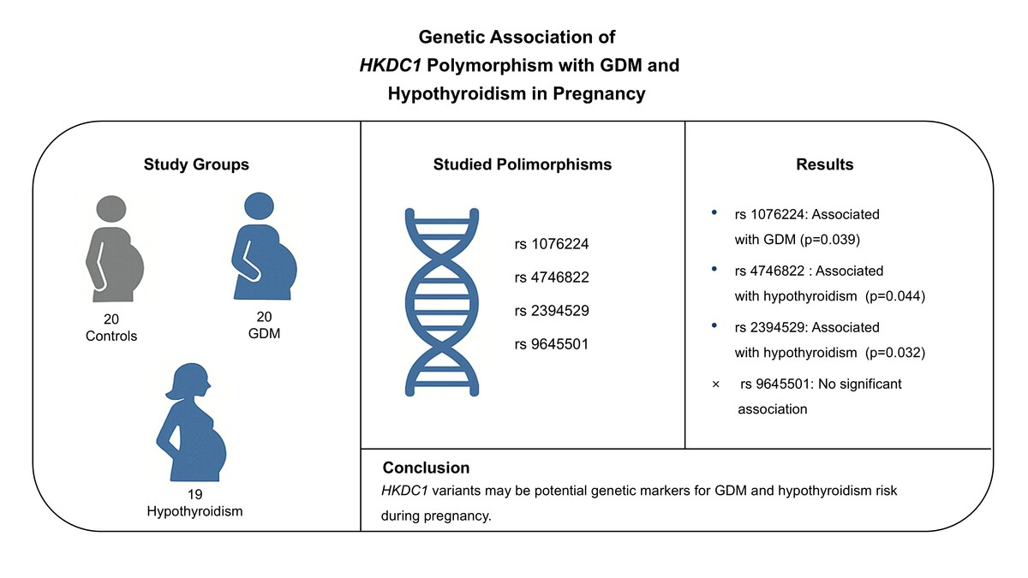

Impact of <i>HKDC1</i> genetic variants on gestational diabetes and hypothyroidism in pregnancy: a pilot study
DOI: 10.5114/aoms/205736
Arch Med Sci 2026;22(3):1787-1793
Notes:
Introduction
Gestational diabetes mellitus (GDM) and hypothyroidism are common pregnancy-related disorders that may have a genetic background. The hexokinase domain containing 1 (HKDC1) gene is involved in glucose metabolism, and its variants may influence thyroid function by modulating metabolic pathways. This interaction could contribute to the development of thyroid dysfunction.
Material and methods
A total of 20 healthy pregnant controls, 20 pregnant women with GDM, and 19 pregnant women with hypothyroidism were genotyped for the HKDC1 gene polymorphisms rs1076224, rs4746822, rs2394529, and rs9645501.
Results
Statistically significant differences were found in the genotype distribution of the HKDC1 rs1076224 polymorphism in the dominant model (G/G vs. A/G + A/A) between women with and without GDM (p = 0.039). Additionally, the HKDC1 rs4746822 polymorphism showed significant differences in both the codominant (p = 0.044) and overdominant (p = 0.014) models between hypothyroid and non-hypothyroid pregnant women. The rs2394529 polymorphism also demonstrated significant differences in the overdominant model (C/C + G/G vs. C/G, p = 0.032) between hypothyroid and non-hypothyroid groups. However, no differences were observed in the genotype or allele frequencies of the HKDC1 rs9645501 variant across the study groups.
Conclusions
This study suggests a potential genetic association between HKDC1 polymorphisms and the risk of GDM and hypothyroidism in pregnancy. The findings highlight rs1076224 as a significant marker for GDM susceptibility, and rs4746822 and rs2394529 as potential markers for hypothyroidism. Further large-scale studies are needed to confirm these associations and understand their clinical implications.

