Slide 1
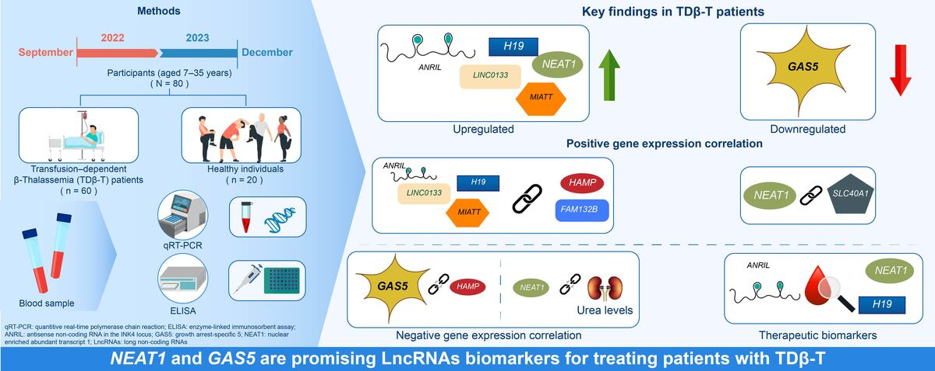

Comprehensive expression of long non-coding RNAs and association with iron and erythropoiesis regulatory proteins in transfusion-dependent β-thalassemia
DOI: 10.5114/aoms/205790
Arch Med Sci 2025;21(6):2671-2679
Notes:
Introduction
β-thalassemia is a genetic disorder characterized by a quantitative defect in β-globin synthesis caused by genetic and epigenetic alterations. However, the expression patterns of long non-coding RNAs (LncRNAs) and their relationship with genes and proteins involved in iron metabolism and erythropoiesis remain largely unknown. We aimed to investigate the expression of LncRNAs and their correlation with iron and erythropoiesis regulatory proteins in patients with transfusion-dependent β-thalassemia (TDβ-T).
Material and methods
Whole blood samples and clinical records were collected from 60 patients with TDβ-T and 20 healthy controls. Expression levels of selected LncRNAs were measured using qRT-PCR. Iron metabolism and erythropoiesis-related proteins were quantified using ELISA.
Results
TDβ-T patients exhibited significantly elevated levels of iron and erythropoiesis regulatory proteins, as well as increased expression of HAMP, GDF-15, FAM132B, and SLC40A1 compared to controls. Additionally, LncRNAs ANRIL, H19, LINCO133, MIAT, and NEAT1 were markedly upregulated, while LncRNA GAS5 was downregulated in patients with TDβ-T. Among these, LncRNAs NEAT1 and GAS5 showed the strongest diagnostic performance. A significant correlation was observed between the expression of HAMP and FAM132B and LncRNAs ANRIL, H19, LINCO133, and MIAT. Furthermore, LncRNA NEAT1 expression correlated positively with SLC40A1 and negatively with urea levels, whereas LncRNA GAS5 was inversely correlated with HAMP expression.
Conclusions
This study is the first to demonstrate altered LncRNA expression patterns and their associations with iron metabolism, erythropoiesis regulatory proteins, and urea levels in patients with TDβ-T. These findings provide new insights for future research and potential therapeutic targets.

