Slide 1
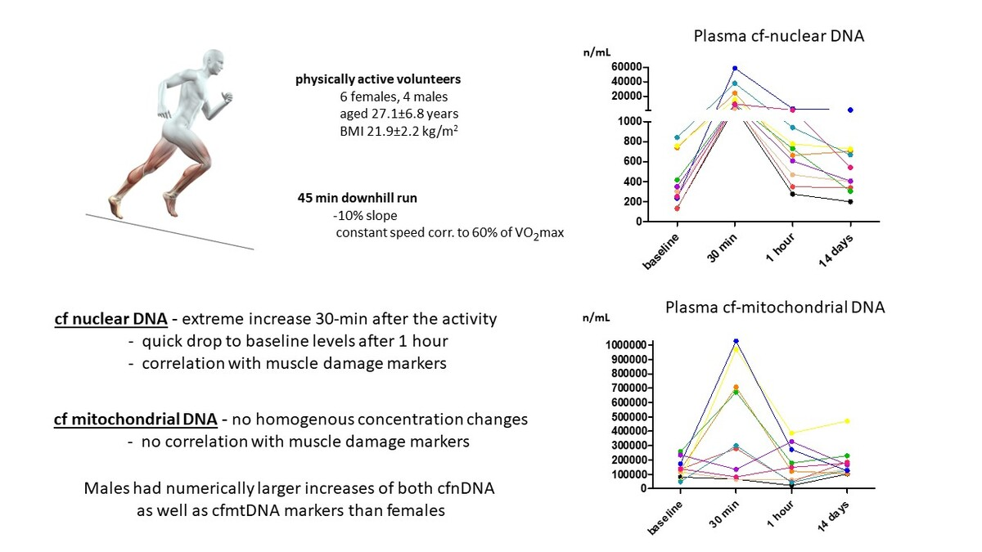

Changes in plasma concentration of cell-free DNA in response to physical activity
DOI: 10.5114/aoms/205792
Arch Med Sci 2025;21(5):1703-1712
Notes:
Introduction
Plasma concentrations of cell-free DNA (cfDNA) serve as markers of overtraining or muscle injury. We examined whether nuclear (n) or mitochondrial (mt) cfDNA has potential as a marker of muscle burden or damage.
Material and methods
Ten healthy, physically active volunteers (6 females, aged 27.1 ±6.8 years) performed a downhill running test. Samples for cfnDNA and cell-free mitochondrial DNA (cfmtDNA) analysis were collected before, 30 min, 1 h, and 14 days after the downhill run. CfnDNA and cfmtDNA (two markers for each) were analyzed using qPCR.
Results
There was an extreme (~40-fold) increase in cfnDNA at the 30-min time-point against the baseline (p < 0.00001 for both markers), followed by a quick drop to baseline levels after 1 h after the end of the downhill run for all subjects. In contrast, plasma levels of cfmtDNA did not increase significantly (p = 0.27 and 0.12). It reflects the fact that in 6 subjects, the pattern was similar as for cfnDNA, but in 4 subjects a decrease of cfmtDNA concentration was observed at the 30-min time-point. These differences correlate with age, body mass index, and sex of the participants. Plasma cfnDNA significantly (p < 0.01 for all) correlated with concentrations of muscle damage markers such as alanine aminotransferase (ALT), aspartate aminotransferase (AST), and lactate dehydrogenase (LD), and chemokines MIP-1 and IP-10 (positive). No homogeneous correlation between cfmtDNA and biomarkers was detected.
Conclusions
Our study confirmed the extreme release and clearance of cfnDNA in physically active subjects after strenuous exercise. In contrast, the trajectory of cfmtDNA concentrations seems to have much higher inter-individual variability than cfnDNA concentrations.

