Slide 1
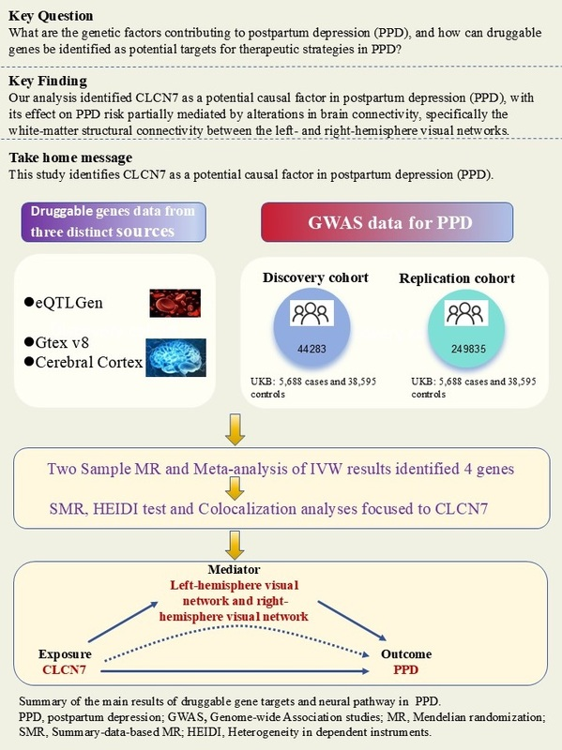

A multi-stage genomic approach to uncover druggable gene targets and neural pathways in postpartum depression
DOI: 10.5114/aoms/206043
Arch Med Sci 2025;21(5):2047-2057
Notes:
Introduction
Postpartum depression (PPD) is a severe emotional disorder affecting women worldwide, with significant impacts on maternal and infant health. Its genetic contributors and biological mechanisms are poorly understood. Identifying druggable genes and clarifying their causal roles may offer insights for developing more effective treatments.
Material and methods
We identified drug-related genes and screened gene expression quantitative trait loci (eQTL) from the eQTLGen consortium and genotype tissue expression (GTEx) v8 dataset, focusing on 13 brain tissues, along with Qi et al.’s meta-study on the cerebral cortex. Mendelian randomization (MR) analyses were used to investigate causal relationships between gene expression and PPD risk. Replication analyses in an independent PPD cohort validated initial findings, and meta-analysis combined MR results. Summary-data-based MR (SMR) and heterogeneity in dependent instruments (HEIDI) tests were also performed, followed by colocalization analyses to assess shared causal variants. Mediation analyses were conducted to explore how genetic effects may influence brain connectivity patterns.
Results
From 5,883 druggable genes, 37 showed potential causal links to PPD. Replication analyses confirmed 9 of these genes, with 4 remaining significant in meta-analysis. SMR and HEIDI analyses focused on CLCN7, which showed robust evidence for causal involvement in PPD. Colocalization analyses suggested shared causal variants, and mediation analyses revealed that CLCN7’s genetic risk is partially mediated by left- to right-hemisphere visual network white-matter structural connectivity.
Conclusions
Our analysis identified CLCN7 as a potential causal factor in PPD, with its effect mediated through brain connectivity. These findings offer targets for future studies and therapeutic strategies for PPD.

