Slide 1
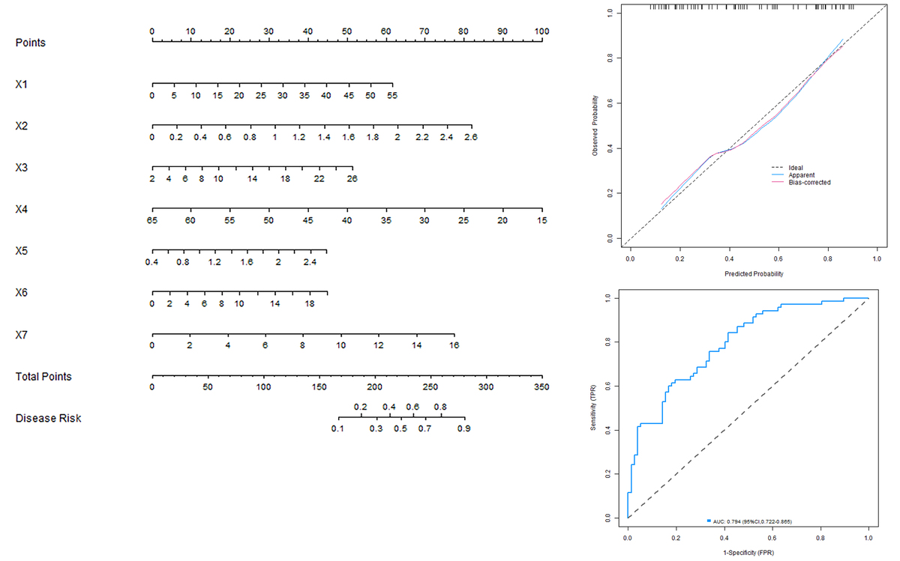

Development and validation of a nomogram prediction model for delayed cerebral edema after intracerebral hemorrhage based on serum inflammatory markers and hemodynamics
DOI: 10.5114/aoms/206974
Arch Med Sci 2026;22(3):1411-1419
Notes:
Introduction
To develop a risk prediction model of delayed cerebral edema after hypertensive cerebral hemorrhage based on serum inflammatory factors and hemodynamics, and to evaluate its clinical application value.
Material and methods
Multivariate logistic regression was used to analyze the risk factors of postoperative bleeding and build a nomogram prediction model, and a receiver operating characteristic (ROC) curve and calibration curve were drawn to evaluate the prediction efficiency of the nomogram model, which was verified in the validation set.
Results
The results of univariate analysis revealed significant differences in interleukin-6 (IL-6), tumor necrosis factor-a (TNF-a), interleukin-1b (IL-1b), macrophage inflammatory protein-1a (MIP-1a), cerebral blood flow (CBF), cerebrovascular reactivity (CVR), high-mobility group Box 1 protein (HMGB1), and C-reactive protein (CRP) between patients with edema and those without edema in training (p < 0.05). Logistic regression analysis showed that IL-6, TNF-a, IL-1b, CBF, CVR, HMGB1 and CRP were independent risk factors for bleeding (p < 0.05). The nomogram model demonstrated good calibration and agreement between prediction and reality in both the training and validation sets (C-index index: 0.792 and 0.799). The results of the Hosmer-Lemeshow test were: c2 = 16.582, p = 0.035 and c2 = 7.472, p = 0.487. ROC curve analysis showed that the area under the curve (AUC) for predicting delayed cerebral edema was 0.794 in the training set and 0.796 in the validation set.
Conclusions
The nomogram prediction model of delayed cerebral edema after hypertensive cerebral hemorrhage based on serum inflammatory factors (IL-6, TNF-a, IL-1b), hemodynamic parameters (CBF, CVR), and other related factors (HMGB1, CRP) was successfully established. The model can effectively predict the risk of delayed cerebral edema in patients with hypertensive cerebral hemorrhage.

