Slide 1
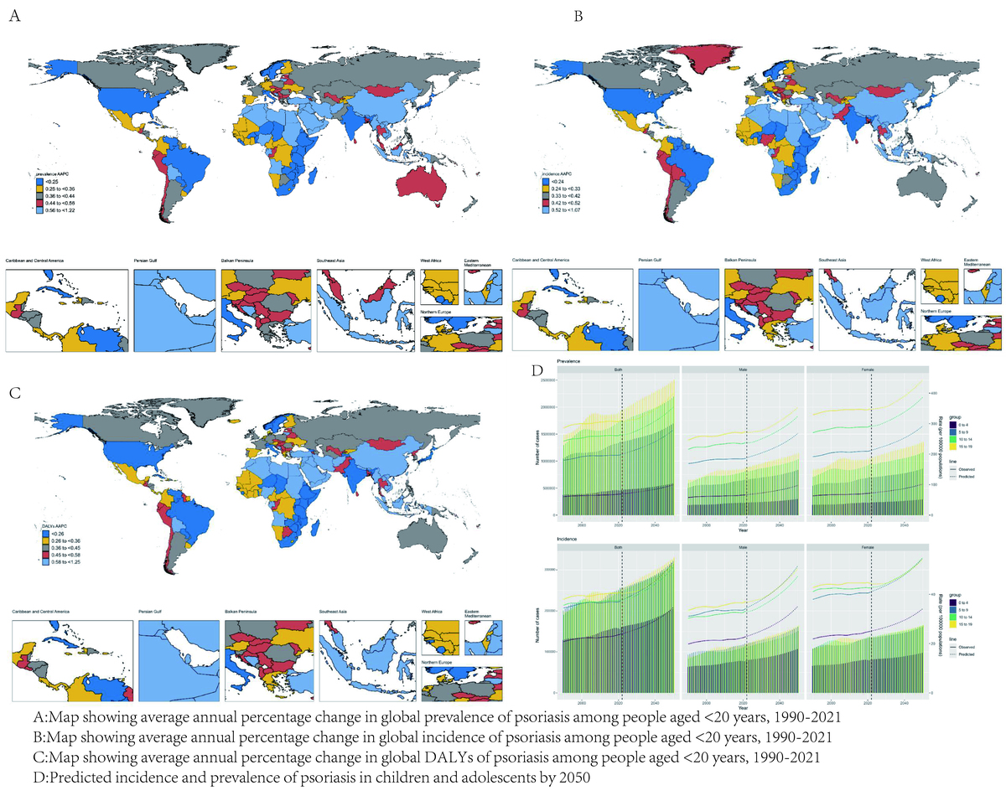

Global burden of psoriasis in children and adolescents, 1990–2021: a population-based study
DOI: 10.5114/aoms/207060
Arch Med Sci 2025;21(3):1091-1094
Notes:
Introduction
Material and methods
Results
Conclusions

