Slide 1
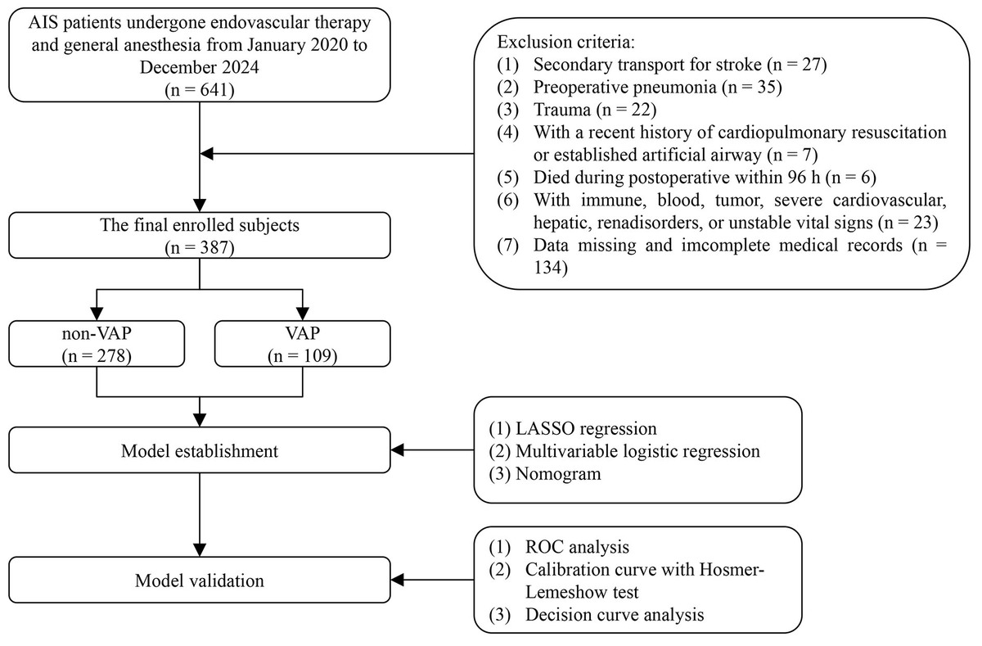

Dynamic serum amyloid A for the prediction of the trajectory of ventilator-associated pneumonia in elderly patients with acute ischemic stroke undergoing endovascular therapy and general anesthesia
DOI: 10.5114/aoms/207061
Notes:
Introduction
In patients with acute ischemic stroke (AIS), current models for predicting ventilator-associated pneumonia (VAP) predominantly rely on multi-parameter approaches, which significantly increase data collection complexity and hinder clinical implementation. Here, we further investigate VAP-related risk factors while dynamically analyzing the predictive value of serum amyloid A (SAA) levels for VAP, aiming to bridge the gap between biomarker-driven simplicity and clinical practicality.
Material and methods
387 patients were ultimately enrolled and divided into two groups: non-VAP (n = 278) and VAP (n = 109). The least absolute shrinkage and selection operator (LASSO), univariate and multivariate logistic regression analyses were utilized to examine the independent risk factors associated with VAP. Calibration and decision curve analysis (DCA) curves were employed to assess the model’s goodness of fit.
Results
A VAP prediction model incorporating seven multimodal clinical parameters, including age, mechanical ventilation duration, DBP, admission NIHSS score, hs-CRP, TC, and SAA-T2, was developed, achieving exceptional predictive performance with an AUC (95% CI) of 0.961 (0.942–0.980). Based on single-parameter AUC values and DCA, SAA-T2 demonstrated the highest diagnostic efficacy and net clinical benefit. The diagnostic performance of Model 1 and SAA-T2 yielded AUCs (95% CI) of 0.889 (0.853–0.924) and 0.885 (0.842–0.928), respectively, with no statistically significant difference between them. Notably, the addition of SAA-T2 to Model 1 significantly enhanced its diagnostic accuracy for VAP.
Conclusions
We developed an excellent nomogram model incorporating seven clinical parameters to predict VAP. SAA-T2 may serve as a rapid and practical clinical indicator for predicting VAP in AIS patients, balancing accuracy with clinical feasibility.

