Slide 1
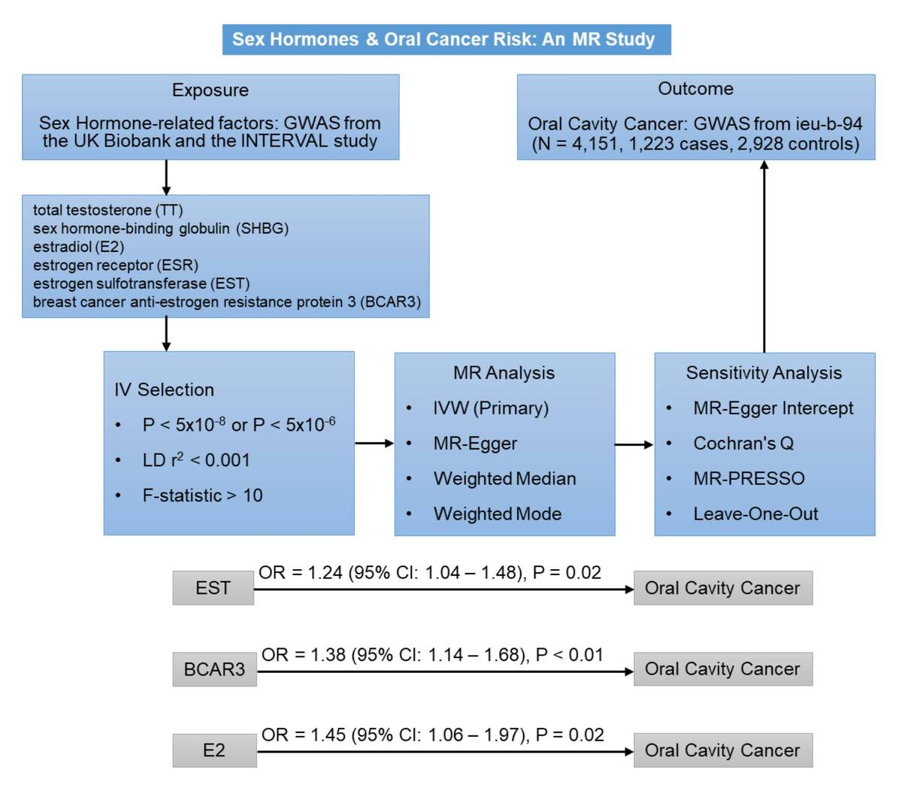

Evaluating the causal relationship between sex hormones and oral cavity cancer: a Mendelian randomization study
DOI: 10.5114/aoms/207194
Arch Med Sci 2026;22(2):1022-1033
Notes:
Introduction
Observational studies on sex hormones and oral cavity cancer show inconsistent results. This two-sample Mendelian randomization (MR) study investigated potential causal associations between genetically predicted levels of six key sex hormone-related factors – total testosterone (TT), sex hormone-binding globulin (SHBG), estradiol (E2), estrogen receptor (ESR), estrogen sulfotransferase (EST), and breast cancer anti-estrogen resistance protein 3 (BCAR3) – and oral cavity cancer risk.
Material and methods
Summary-level data from genome-wide association studies (GWAS) for exposures and oral cavity cancer, obtained via the IEU OpenGWAS, were analyzed using inverse variance weighted (IVW) as the primary method, complemented by weighted median, weighted mode, and MR-Egger regression. Sensitivity analyses included MR-Egger regression (directional pleiotropy), Cochran’s Q (heterogeneity), and MR-PRESSO (outlier detection/correction).
Results
IVW analysis linked genetically predicted higher EST (OR = 1.24, 95% CI: 1.04–1.48, p = 0.02) and BCAR3 (OR = 1.38, 95% CI: 1.14–1.68, p < 0.01) to increased oral cavity cancer risk. After removing one outlier SNP, a significant association was also observed between E2 and oral cavity cancer (OR = 1.45, 95% CI: 1.06–1.97, p = 0.02). No significant relationships were found for TT, ESR, and SHBG. These findings were consistent across weighted median, weighted mode, and MR-Egger regression. MR-Egger regression did not indicate significant directional pleiotropy. For E2, initial heterogeneity was resolved after outlier correction, while EST and BCAR3 showed no significant heterogeneity.
Conclusions
To our knowledge, this is the first comprehensive MR study linking sex hormone-related factors (E2, EST, BCAR3) to increased oral cavity cancer risk. Further validation is needed to explore prevention and treatment implications.

