Slide 1
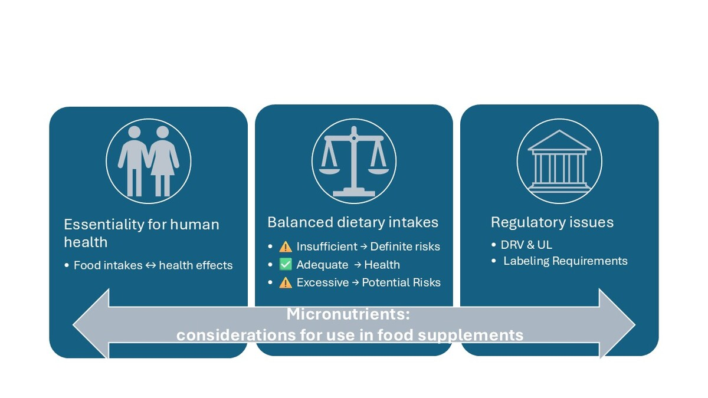

Definition of maximum daily amounts of vitamins and minerals allowed in food supplements: scientific rationale and European regulatory frameworks
DOI: 10.5114/aoms/207235
Arch Med Sci 2025;21(5):2020-2029
Notes:
Ensuring an adequate supply of essential micronutrients while preventing excessive intakes that could lead to adverse effects presents a challenge in the context of food supplement regulation, in the absence of harmonization in the European Union. This paper examines the scientific rationale and regulatory frameworks governing the definition of maximum allowable levels for vitamins and minerals in food supplements. Existing legislation, scientific literature, and institutional documents were considered, focusing on the different factors influencing the risk-benefit assessment, such as dietary habits, selection of the reference population, and the contribution of fortified and enriched foods to total nutrient intake. While a precautionary approach has been proposed to prevent potential risks linked to excessive intakes, too restrictive limits may undermine the nutritional role of supplementation. Future regulatory frameworks should integrate both safety and efficacy considerations, ensuring that supplements contribute meaningfully to micronutrient adequacy while preventing excessively high intake levels.

