Slide 1
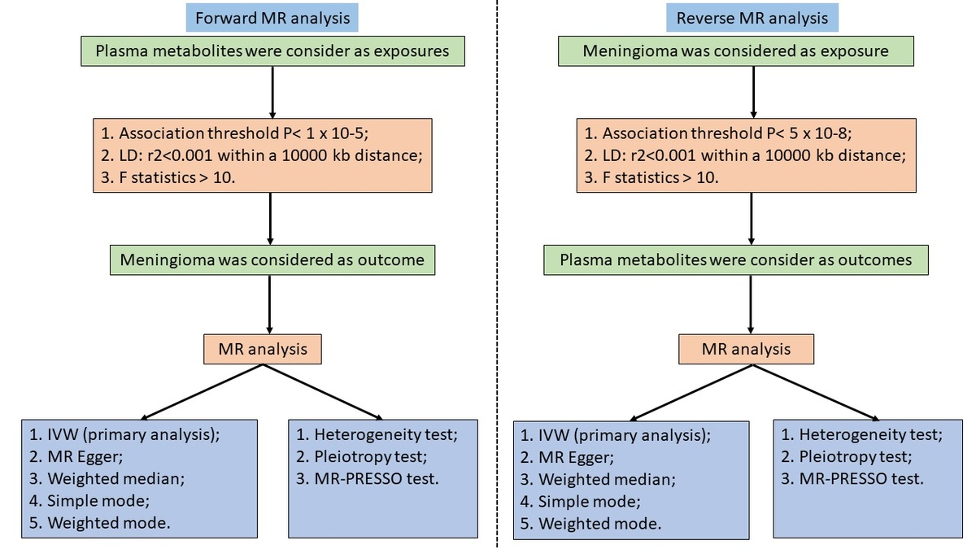

Mendelian randomization identifies the characteristic plasma metabolite profile of meningioma
DOI: 10.5114/aoms/207320
Arch Med Sci 2025;21(6):2589-2602
Notes:
Introduction
Meningioma, a prevalent intracranial tumor, presents diagnostic and therapeutic challenges due to its heterogeneous nature. Metabolic profiling has emerged as a promising approach to elucidate its underlying molecular mechanisms and discover potential biomarkers.
Material and methods
This study employed bidirectional Mendelian randomization (MR) analysis to investigate the causal relationship between plasma metabolites and meningioma risk. Genetic instruments were used as surrogates for both plasma metabolites and meningioma, allowing MR analysis in both directions to assess the impact of metabolites on meningioma risk and vice versa. This study encompassed data on 1400 plasma metabolites and 314,708 participants (1316 individuals diagnosed with meningioma and 313,392 individuals without meningioma).
Results
Initially, 46 plasma metabolites/metabolite ratios were found to be associated with meningioma risk (p < 0.05), with 23 associated with a decreased risk and 23 associated with an increased risk of meningioma. Furthermore, the identified relationships between the 46 plasma metabolites/metabolite ratios and meningioma showed no significant horizontal pleiotropy (p > 0.05), suggesting that the results are not influenced by other confounding factors. Reverse MR analysis revealed that meningioma has no significant impact on the levels of 24 plasma metabolites/metabolite ratios, and is unaffected by confounding factors. In addition, the identified plasma metabolites influence the occurrence of meningioma through nine metabolic pathways.
Conclusions
The findings of this bidirectional MR study indicate that 24 plasma metabolites/metabolite ratios lead to a significantly increased/decreased risk of meningioma, suggesting that the plasma metabolite profile characteristics serve as important serological tools for the early diagnosis of meningioma.

