Slide 1
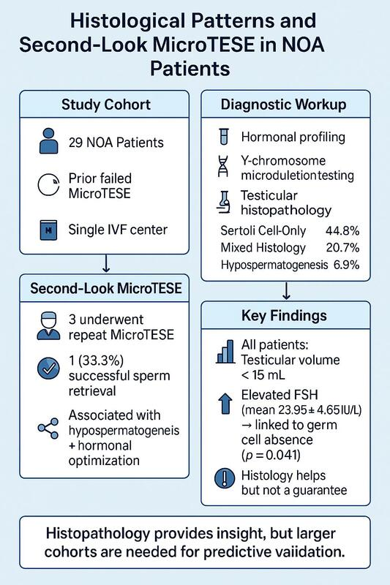

Exploratory insights into histopathological patterns and repeat micro-TESE outcomes in non-obstructive azoospermia: a retrospective single-center study
DOI: 10.5114/aoms/207428
Arch Med Sci 2025;21(3):1085-1090
Notes:
Introduction
Material and methods
Results
Conclusions

