Slide 1
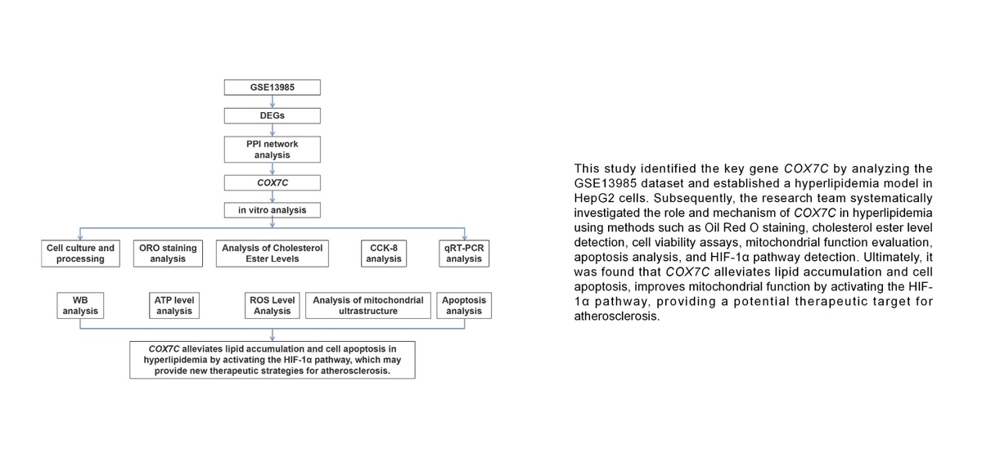

COX7C alleviates lipid accumulation and apoptosis in a hyperlipidemia model via the HIF-1α pathway
DOI: 10.5114/aoms/207429
Arch Med Sci 2026;22(2):940-957
Notes:
Introduction
One of the main contributing factors to the growth of atherosclerosis is hyperlipidemia (HLP). COX7C is a mitochondrial protein that is essential to mitochondrial function and cellular homeostasis. However, its role in hyperlipidemia and atherosclerosis remains underexplored. The aim of the study was to investigate the function of COX7C in lipid accumulation, mitochondrial function, and apoptosis in a hyperlipidemia model, and explore its mechanism of action through the HIF-1α pathway.
Material and methods
Bioinformatics analysis of the GSE13985 dataset was performed, and COX7C was selected as a hub gene. Free fatty acids were used to treat HepG2 cells to establish a hyperlipidemia model. Lipid buildup was assessed by oil red O (ORO) staining, and cholesterol ester levels, adenosine triphosphate content, and reactive oxygen species (ROS) levels were quantified using kit assays. Western blot (WB), flow cytometry, and CCK-8 were employed to assess protein expression levels, cell viability, and apoptosis. The effects of HIF-1α inhibition were investigated using the HIF-1α inhibitor KC7F2.
Results
Overexpression of COX7C significantly reduced lipid accumulation, improved cell viability, and alleviated mitochondrial damage in a hyperlipidemia model. Flow cytometry and WB research on apoptosis-related proteins demonstrated that COX7C overexpression also reduced ROS production and inhibited apoptosis. In addition, COX7C overexpression activated the HIF-1α pathway, further alleviating mitochondrial damage and apoptosis. KC7F2 reversed the protective effect of COX7C, indicating that COX7C acts through the HIF-1α pathway in the context of hyperlipidemia.
Conclusions
COX7C reduces lipid accumulation and apoptosis in a hyperlipidemia model by activating the HIF-1α pathway and may provide a therapeutic strategy for atherosclerosis.

