Slide 1
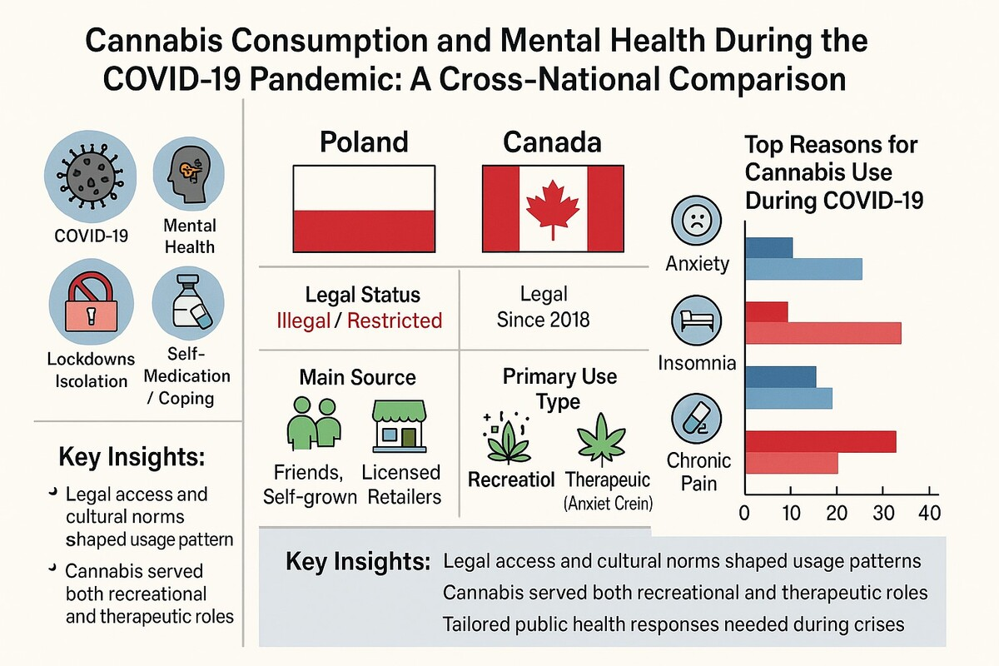

Changes in cannabis use during the COVID-19 pandemic: a comparison between Poland and Canada
DOI: 10.5114/aoms/207491
Arch Med Sci 2025;21(3):1095-1098
Notes:
Introduction
Material and methods
Results
Conclusions

