Slide 1
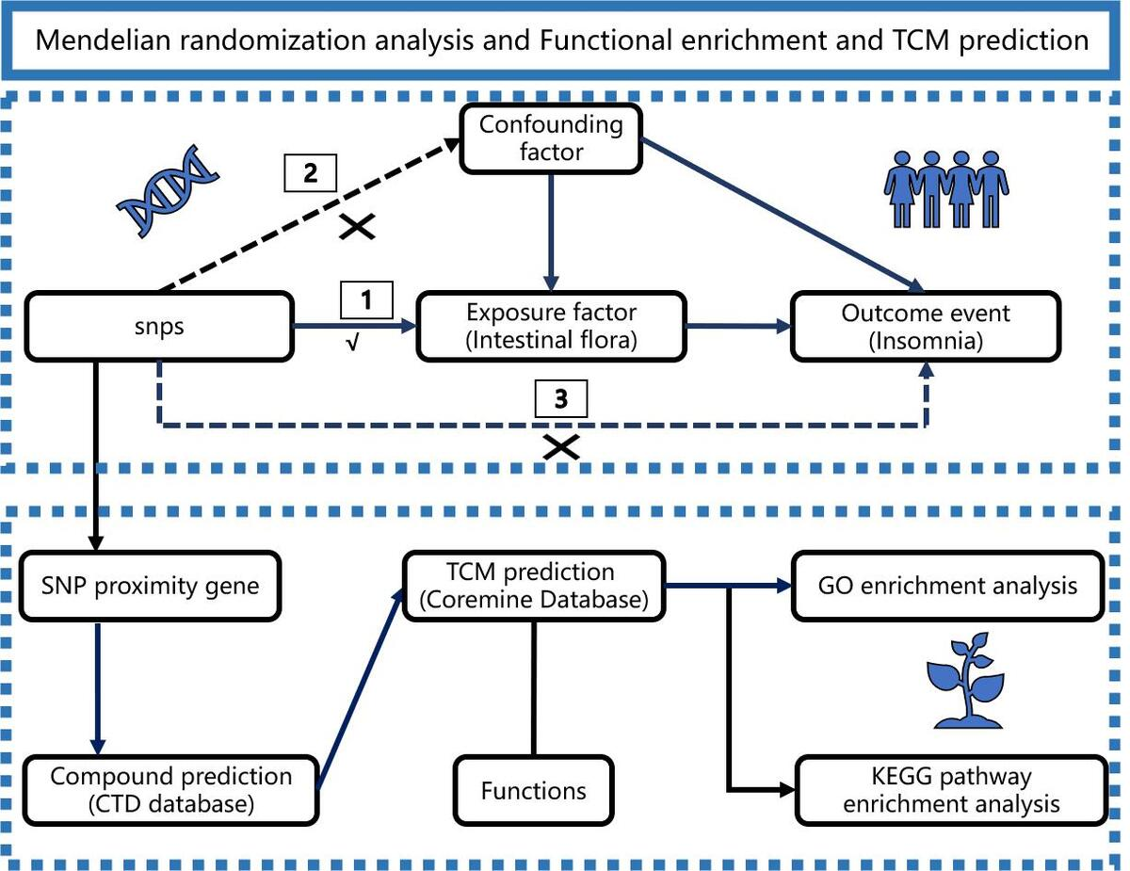

Gut microbiota and insomnia: Mendelian randomization and network pharmacology to predict potential intervention with traditional Chinese medicine
DOI: 10.5114/aoms/207509
Arch Med Sci 2025;21(5):1821-1835
Notes:
Introduction
The aim of the study was to identify gut microbiota (GM) with genetic causal effects on insomnia using Mendelian randomization (MR) and predict potential traditional Chinese medicines (TCMs) for GM-targeted intervention in insomnia.
Material and methods
Summary data from genome-wide association studies (GWAS) on GM and insomnia were obtained from the IEU OpenGWAS database. The R 4.4.1 software, particularly the TwoSampleMR package, was utilized to assess the genetic correlation between GM and insomnia, primarily using the inverse-variance weighted (IVW) method. Functional enrichment analysis was conducted on the genes adjacent to the instrumental variables to explore the signaling pathways through which related GM may mediate insomnia. The CTD and Coremine databases were combined to predict TCM with potential regulatory effects on the genes adjacent to the instrumental variables, and their properties, meridian tropism, and efficacy information were compiled.
Results
The MR analysis revealed that Ruminococcaceae and Marvinbryantia were associated with an increased risk of insomnia, while Pasteurellaceae, Olsenella, the Ruminococcus gnavus group, Mollicutes RF9, and Pasteurellales were associated with a decreased risk. The genes adjacent to the instrumental variables were mainly enriched in signaling pathways such as neuroactive ligand-receptor interaction and the mammalian target of rapamycin (mTOR). Representative TCM with high mapping frequencies included Panax ginseng, Curcuma aromatica, Salviae Miltiorrhizae Radix, Zingiber officinale, Glycyrrhizae Radix et Rhizoma, Aucklandiae Radix, Magnoliae Officinalis Cortex, Scutellariae Radix, Ganoderma lucidum, and Poria cocos.
Conclusions
The MR analysis identified seven GM, represented by Ruminococcaceae and Marvinbryantia, that may mediate the occurrence and development of insomnia through signaling pathways such as mTOR and neuroactive ligand-receptor interaction. It predicted potential traditional Chinese medicines that act on GM to intervene in insomnia. This study provided a reference for exploring TCM prevention and treatment strategies for insomnia from the perspective of GM.

