Slide 1
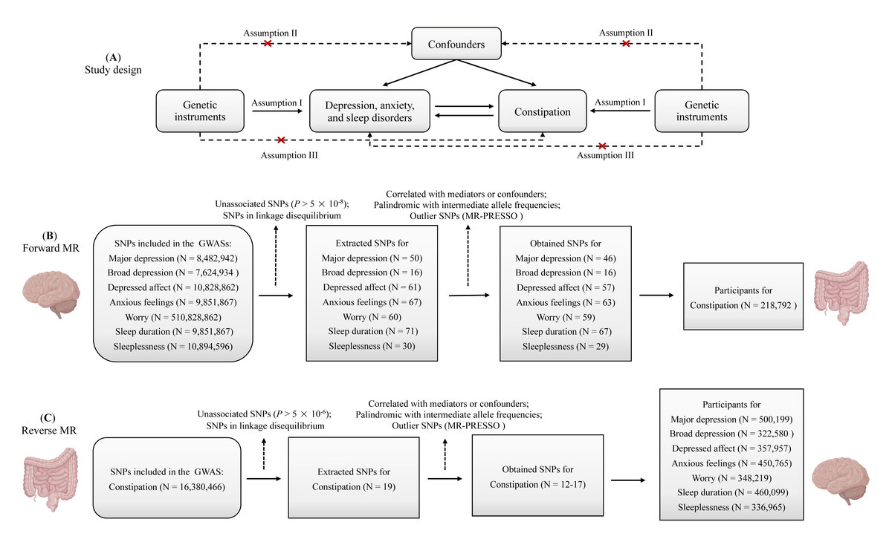

Bidirectional associations of depression, anxiety, sleep disorders, and constipation: insights from Mendelian randomization
DOI: 10.5114/aoms/207613
Arch Med Sci 2026;22(2):1001-1010
Notes:
Introduction
Mental health disorders and constipation are increasingly prevalent health problems worldwide. Previous studies have reported bidirectional associations between depression, anxiety, sleep disorders, and constipation. However, observational studies have yielded inconsistent results.
Material and methods
The associations were examined through a two-sample, bidirectional, univariable, and multivariable Mendelian randomization (MR) study. Summary-level data were obtained from the UK Biobank, large consortia, and the FinnGen consortium. The inverse-variance weighted method was applied as the principal analytical approach, and other additional MR methods (maximum likelihood, MR-RAPS, and MR-PRESSO) were used for sensitivity analyses. Multivariable MR analysis was performed to assess the independent effects of selected exposures.
Results
The univariable MR analyses indicated that major depression (MD) (OR = 1.28; 95% CI: 1.12–1.46), broad depression (BD) (OR = 3.72; 95% CI: 1.55–8.97), depressed affect (OR = 1.41; 95% CI: 1.13–1.76), and worry (OR = 1.42; 95% CI: 1.13–1.77) were associated with an increased risk of constipation. There was no evidence supporting the causal effects of anxious feelings, sleep duration, and sleeplessness on constipation. The reverse MR analyses found no reverse causal association of constipation with depression, anxiety, and sleep disorders. In multivariable MR, only MD still had a robust causal association with constipation, while the effect of worry was attenuated to null, and the effects of BD and depressed affect were completely reversed.
Conclusions
MD is causally associated with constipation, and worry might also increase the risk of constipation. Future studies are needed to confirm the causality and elucidate the underlying mechanisms.

