Slide 1
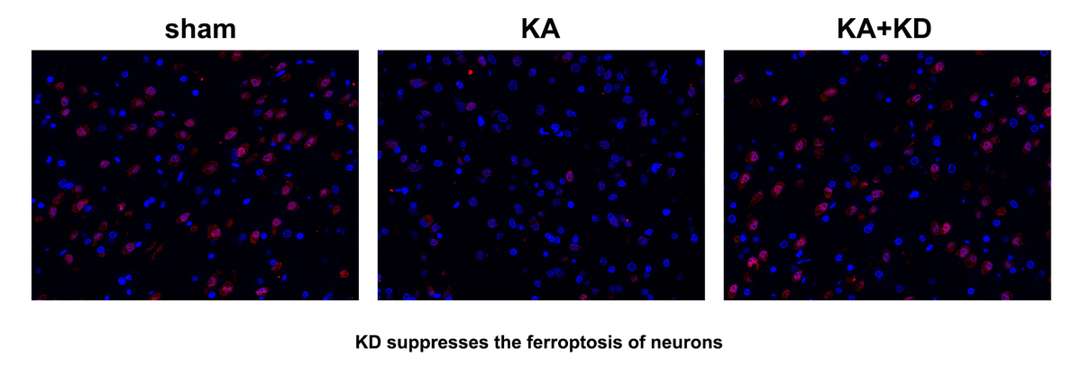

The ketogenic diet alleviates neuronal ferroptosis in epilepsy via HDAC4/TFRC signalling
DOI: 10.5114/aoms/207708
Arch Med Sci 2026;22(1):290-300
Notes:
Introduction
Ketogenic diets (KD) recapitulate certain metabolic aspects of dietary restriction such as reliance on fatty acid metabolism and production of ketone bodies. This study aimed to investigate whether a KD might, like dietary restriction, affect brain functions in epilepsy.
Material and methods
Kainic acid (KA) injection was used to establish an epilepsy model in vivo. Histone deacetylation 4 (HDAC4) mRNA expression was determined using RT-qPCR. Protein expression was detected using western blot. Gene expression was determined using immunofluorescence. The release of malondialdehyde (MDA), ferrous iron, and glutathione (GSH) was detected using corresponding commercial kits. The interaction between HDAC4 and transferrin receptor (TFRC) was verified using co-immunoprecipitation assay. Neuronal viability was detected using Cell Counting Kit 8 (CCK-8) assay. Neuronal death was detected using propidium iodide (PI) staining.
Results
Epilepsy mediated iron accumulation- and lipid peroxidation-induced neuronal ferroptosis. Interestingly, KD treatment alleviated epilepsy as well as the accumulation of ferrous iron and lipid peroxidation, resulting in the inhibition of neuronal ferroptosis in epileptic models in vivo and in vitro. Mechanically, KD promoted the upregulation of HDAC4, which inhibited the acetylation of TFRC and suppressed its protein expression. However, downregulation of HDAC4 by its specific inhibitor LMK235 promoted the ferroptosis of neurons.
Conclusions
Collectively, KD protect against the ferroptosis of neurons in epilepsy via promoting HDAC4-mediated deacetylation and downregulation of TFRC. Therefore, KD may be a promising strategy for epilepsy.

