Slide 1
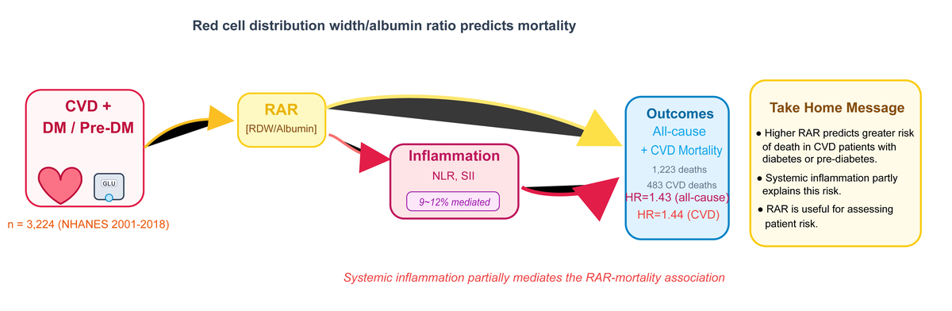

The role of systemic inflammation in mediating the association between red cell distribution width/albumin ratio and all-cause and cardiovascular mortality in cardiovascular disease patients with diabetes or prediabetes: insights from a large, population-based study
DOI: 10.5114/aoms/207709
Notes:
Introduction
The association between red cell distribution width-to-albumin ratio (RAR) and clinical outcomes in cardiovascular disease (CVD) patients with diabetes mellitus (DM) or pre-DM remains unclear, and its underlying mechanisms are not fully understood.
Material and methods
This population-dependent prospective cohort study enrolled 3224 United States (U.S.) participants from the National Health and Nutrition Examination Survey (NHANES) (2001–2018) who had both CVD and either DM or pre-DM. Using the National Death Index data, the cohort’s mortality outcomes were tracked until December 31, 2019. Cox proportional hazard models and restricted cubic spline regressions were employed to investigate the associations between RAR and mortality outcomes. Notably, mediation analyses were performed to quantify the contribution of inflammatory markers, including neutrophils, monocytes, the neutrophil-to-lymphocyte ratio (NLR), and the systemic immune-inflammation index (SII), in the RAR-mortality relationship.
Results
During a median 78-month follow-up, 1,223 deaths occurred (483 cardiovascular-related). Elevated RAR was significantly associated with increased all-cause mortality (hazard ratio = 1.43, 95% CI: 1.31–1.56) and cardiovascular mortality (1.44, 1.28–1.62). NLR and SII exhibited significant mediating effects (8.8–10.79% for all-cause; 9.58–11.99% for cardiovascular mortality).
Conclusions
Elevated RAR was significantly associated with increased risk of all-cause mortality and cardiovascular mortality among patients with CVD and DM or pre-DM. Systemic inflammation significantly mediated these associations. RAR may serve as a practical prognostic marker in this high-risk population.

