Slide 1
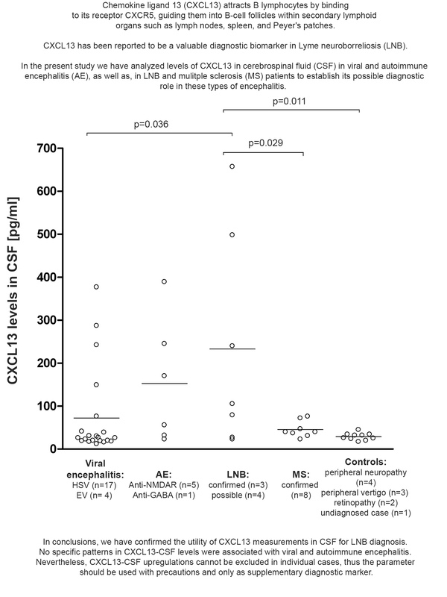

Diagnostic value of cerebrospinal fluid chemokine ligand 13 (CXCL13) levels for viral and autoimmune encephalitis
DOI: 10.5114/aoms/207801
Arch Med Sci 2026;22(2):841-847
Notes:
Introduction
Chemokine ligand 13 (CXCL13) has been reported to be a valuable diagnostic biomarker in Lyme neuroborreliosis (LNB). However, its utility in the diagnostics of viral and autoimmune (AE) encephalitis still remains unclear.
Material and methods
We measured CXCL13 concentrations in cerebrospinal fluid (CSF) samples collected from 21 patients with viral encephalitis (17 cases of herpes simplex viral (HSV) and 4 of enteroviral (EV) encephalitis) and 6 patients with AE (5 subjects with antibodies anti-NMDAR and 1 with anti-GABA) and compared them to those found in patients with LNB (7 subjects) and multiple sclerosis (8 cases) as well as ten control subjects without neuroinflammation.
Results
Patients with neuroinflammation had a mean level of CXCL13-CSF of 105 pg/ml compared to 29 pg/ml in controls. The highest mean level of CXCL13 in CSF was detected in LNB patients (233 pg/ml), and the lowest in controls (29 pg/ml). Significant upregulation of CXCL13-CSF levels in LNB patients was observed in comparison to viral encephalitis and MS patients as well as controls. A positive correlation between elevated chemokine levels and cell count in CSF was found in all patients (r = 0.6496; p < 0.0001), as well as in the LNB group when tested alone (r = 0.8428; p = 0.0173). A positive correlation with CSF protein levels was observed in all patients (r = 0.7216; p < 0.0001), and separately in LNB (r = 0.8573; p = 0.0137) and AE patients (r = 0.8885; p = 0.0180).
Conclusions
The findings support the utility of CXCL13 measurements in CSF for LNB diagnosis. No specific patterns in CXCL13-CSF levels were associated with viral or autoimmune encephalitis.

