Slide 1
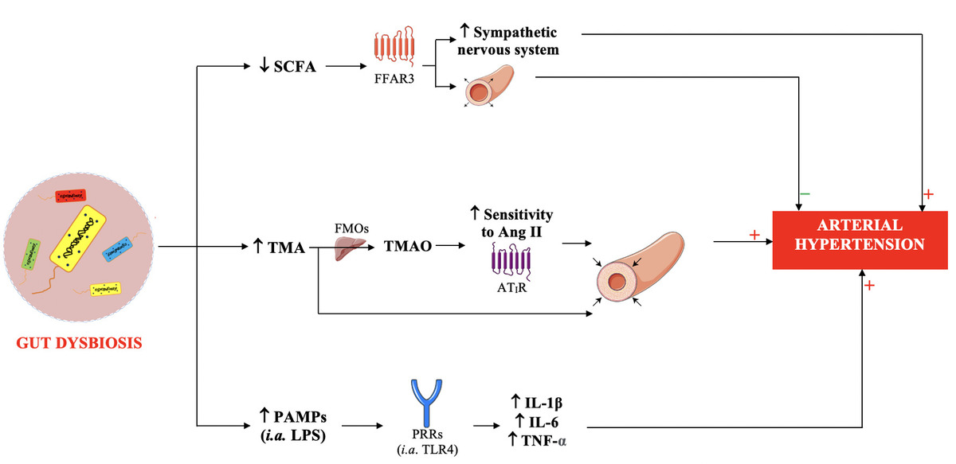

Gut microbiota and arterial hypertension: a narrative review
DOI: 10.5114/aoms/208012
Arch Med Sci 2025;21(5):2007-2019
Notes:
In patients with hypertension, intestinal dysbiosis and increased intestine permeability are commonly observed. Modifications of intestinal microbiota with certain probiotics, prebiotics, and synbiotics, as well as gut microbiota transfer, have been associated with a reduction in blood pressure. Therefore, these interventions, especially probiotics, can be employed as adjuncts to hypertension therapy. Bacteria constituting dysbiotic intestinal microbiota produce compounds with hypertensinogenic activity (trimethylamine – TMA, pathogen-associated molecular patterns – PAMPs). In addition, in a state of dysbiosis, a decrease in the production of compounds with antihypertensive activity (short-chain fatty acids – SCFAs) is observed. A diet high in salt significantly alters the intestinal microbiota, and such dysbiosis has been implicated in the pathogenesis of salt-sensitive hypertension. This narrative review article discusses the importance of the gut microbiota, its dysbiosis in patients with hypertension, and potential therapeutic options.

