Slide 1
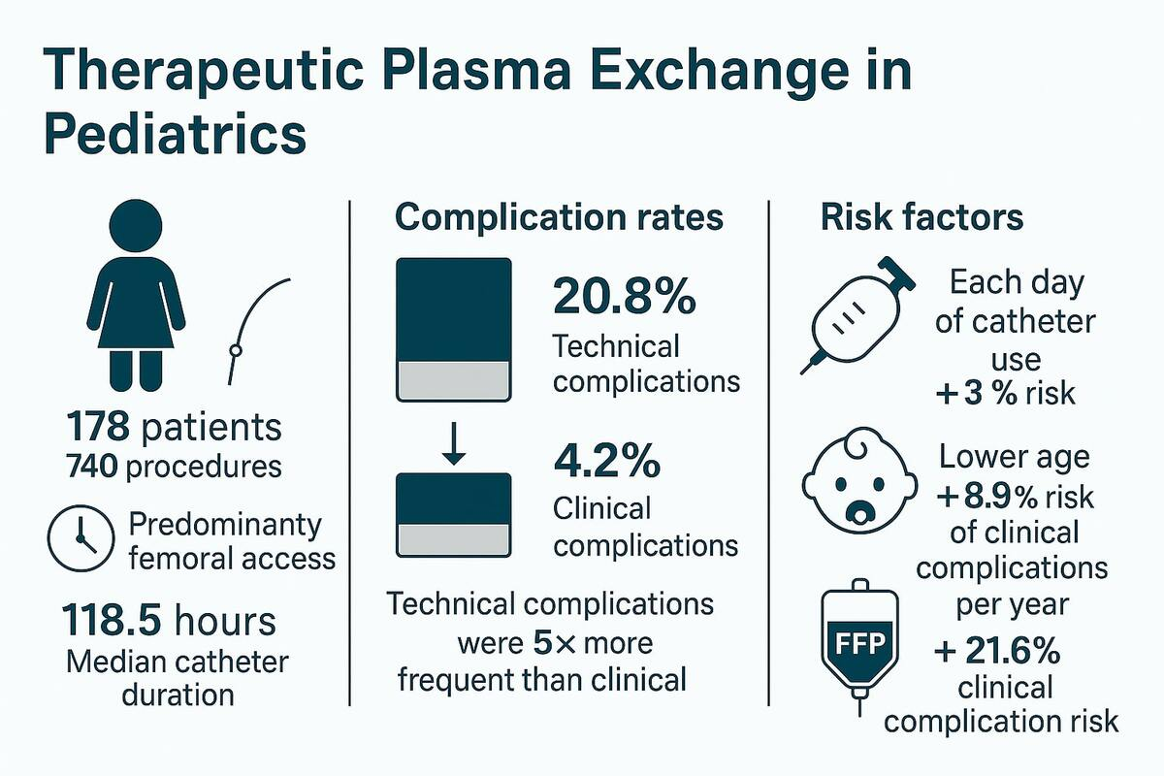

Key technical aspects and vascular access safety in membrane-based therapeutic plasma exchange for the pediatric population
DOI: 10.5114/aoms/208105
Arch Med Sci 2026;22(3):1562-1573
Notes:
Introduction
Therapeutic plasma exchange (TPE) is a widely used extracorporeal blood purification procedure. While its principles are similar across age groups, the technical complexity and risks are heightened in pediatric patients due to unique technical considerations. This study assessed the safety regarding both technical and clinical complications of vascular access and membrane-based TPE filters in a pediatric population at a single center.
Material and methods
This retrospective cohort study reviewed charts of patients undergoing TPE at a level 3 referral center over 25 years.
Results
The study involved 178 patients undergoing a total of 740 procedures during 214 sessions, predominantly using femoral vascular access. The median duration of the entire TPE sessions (treated as a surrogate for catheter lifespan) was 118.5 hours. Technical complications occurred in 20.8% of procedures (31.6% of events), while clinical complications occurred in 4.2% (4.7% of events). Technical complications were nearly five times more frequent than clinical complications, with technical events being 6.7 times more common. The proportion of patients experiencing clinical complications was 15.2%. Logistic regression demonstrated that each additional day of catheter placement increased the probability of technical complications by 3%. Additionally, each year of patient age decreased the likelihood of clinical complications by 8.9%, while fresh frozen plasma (FFP) supplementation within a session increased the probability of clinical complications by 21.6%.
Conclusions
Prolonged catheter use increases technical events, while FFP supplementation elevates catheter-related clinical complication risk. Advancing patient age reduces the likelihood of clinical complications, underscoring age-specific safety considerations in pediatric TPE.

