Slide 1
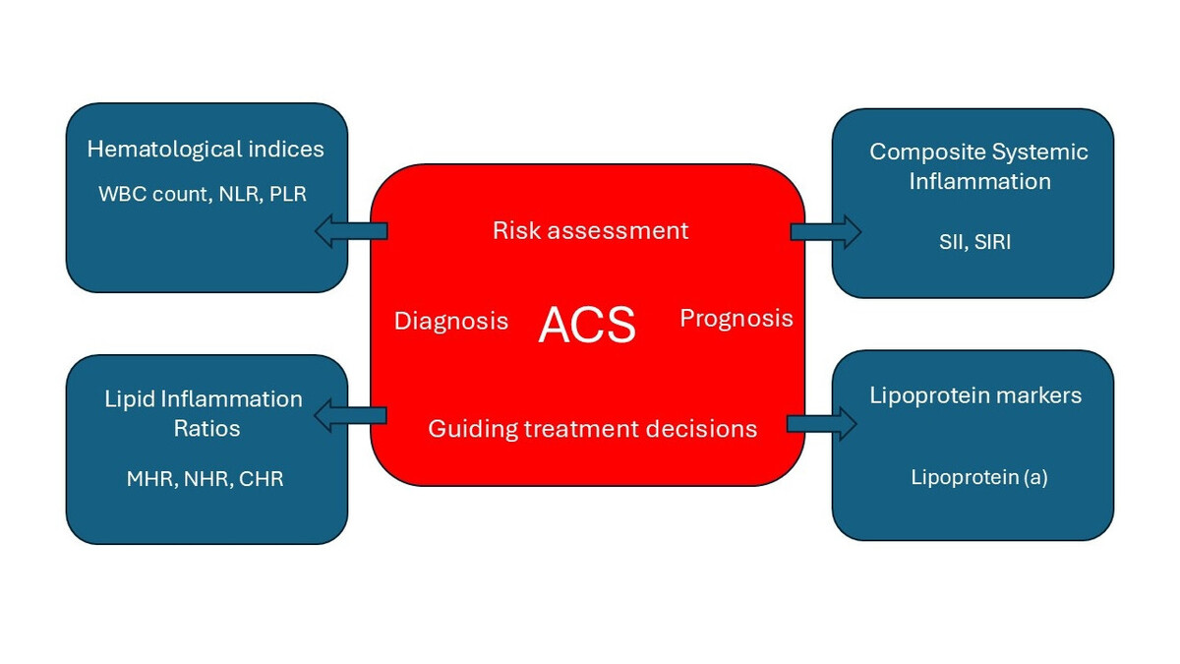

Updated focused review of hematological, inflammatory, and lipid biomarkers in acute coronary syndrome
DOI: 10.5114/aoms/208106
Arch Med Sci 2025;21(6):2258-2266
Notes:
At present, hematological indices and biomarkers of inflammation that may be associated with atherosclerosis and the prediction of acute coronary syndromes (ACS) attract a lot of academic attention. This updated focused review aims to provide an overview of selected ACS biomarkers: white blood cells, neutrophil to lymphocyte ratio, platelet to lymphocyte ratio, systemic inflammatory index (SII), systemic inflammatory response index (SIRI) and lipoprotein(a). Novel inflammatory-lipid biomarkers such as high-sensitivity C-reactive protein (hsCRP) to high-density lipoprotein cholesterol (HDL-C) ratio, neutrophil to HDL-C ratio, and monocyte to HDL-C ratio may improve ACS diagnosis, risk stratification, clinical prognosis, and optimal management. These indices are inexpensive and easily obtained in daily clinical practice. Artificial intelligence and genetic analysis may improve their diagnostic performance and guide clinical management. The recent data also emphasize that these indices may be promising clinical tools for assessing ACS patients and monitoring the effectiveness of emerging anti-inflammatory strategies.

