Slide 1
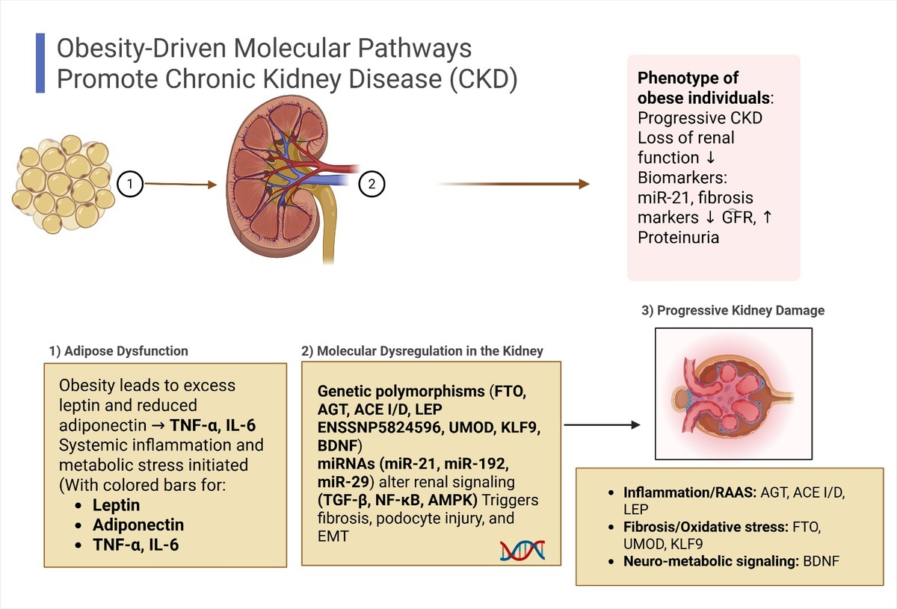

A review of the literature on obesity-related chronic kidney disease: a molecular description of gene susceptibility to polymorphisms, noncoding RNAs, and pathophysiology
DOI: 10.5114/aoms/208192
Arch Med Sci 2025;21(4):1130-1140
Notes:
Obesity significantly contributes to the development and progression of chronic kidney disease (CKD) by inducing metabolic and hemodynamic disturbances that drive gene dysregulation, inflammation, fibrosis, and renal structural injury. Key molecular mediators include genetic polymorphisms – such as AGT rs699, ACE I/D, LEP ENSSNP5824596, and FTO rs17817449 – and epigenetic regulators like microRNAs (e.g., miR-21, miR-192) and long non-coding RNAs (e.g., ANRIL, HOTAIR). These alterations affect signaling cascades such as TGF-/Smad3, NF-B, and AMPK, accelerating renal damage in obese individuals. Despite advances, reliable biomarkers and therapeutic targets remain scarce. This review integrates current evidence on the genetic and epigenetic basis of obesity-related CKD, offering a framework for early detection and precision medicine.

