Slide 1
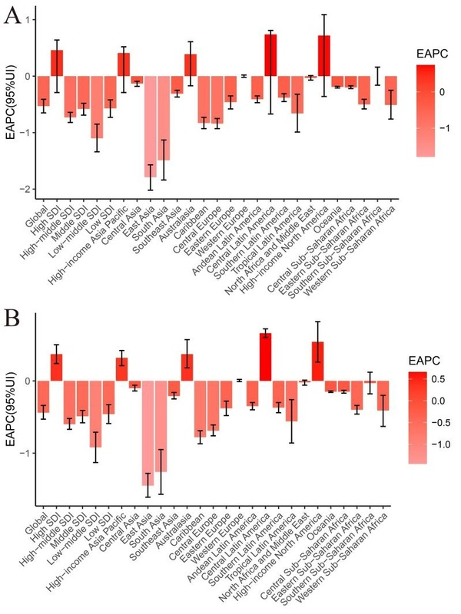

The burden of depression among women of childbearing age globally from 1990 to 2019
DOI: 10.5114/aoms/208221
Arch Med Sci 2025;21(5):1836-1848
Notes:
Introduction
We aimed to estimate the incidence of depression among women of childbearing age between 1990 and 2019 in terms of age, sex, country, and Socio-Demographic Index (SDI).
Material and methods
This study analyzed trends in age-standardized incidence rates (ASIR) and disability-adjusted life years (DALYs) using data from the Global Burden of Disease Study. We calculated the estimated annual percentage change (EAPC) and its corresponding 95% confidence interval (CI).
Results
From 1990 to 2019, the ASIR (per 100,000) and age-standardized DALY rate (per 100,000) of depression in women of childbearing age showed a decreasing trend, with EAPC values of –0.53 and –0.44, respectively. Singapore’s ASIR and Cuba’s age-standardized DALY rate had the lowest EAPC (–2.24 and –2.11). Among the 21 geographical regions, the ASIR and DALY in Central Latin America had the highest EAPC (EAPC of 0.74 and 0.66, respectively), while East Asia had the lowest EAPC (–1.79 and –1.45, respectively). When looking at the changes in ASIR and age-standardized DALY rates from a national perspective, Mexico, Spain, and Germany had the largest increases in ASIR and age-standardized DALY rates. The EAPCs of depression ASIR in women of childbearing age were 1.55, 1.46, and 1.17, respectively, and the EAPCs of depression age-standardized DALY rates in women of childbearing age were 1.40, 1.29, and 1.01, respectively.
Conclusions
From 1990 to 2019, there was a consistent downward trend in the burden of depression in women of childbearing age globally. However, certain countries and regions such as Central Latin America (including Mexico) experienced an upward trend in ASIR and age-standardized DALY rates.

