Slide 1
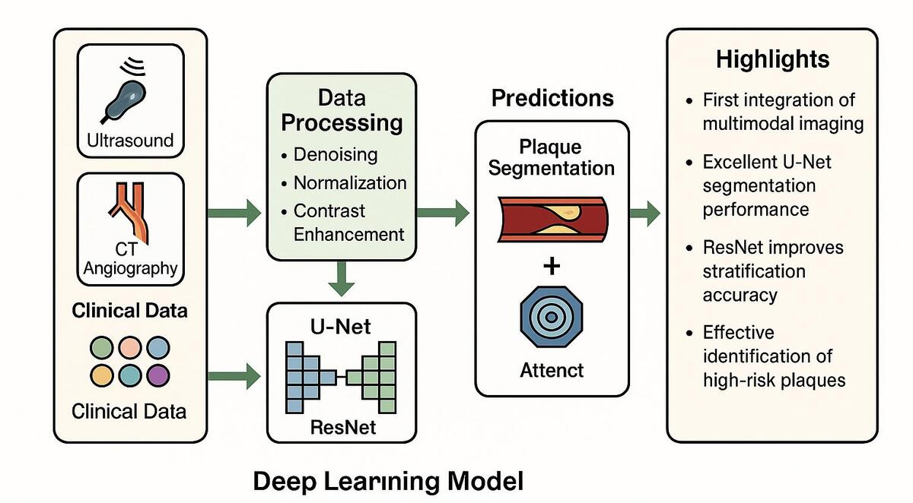

Deep learning-based multimodal risk stratification for atherosclerosis management
DOI: 10.5114/aoms/208224
Arch Med Sci 2025;21(5):1745-1755
Notes:
Introduction
Atherosclerosis is a leading cause of cardiovascular events, requiring accurate risk stratification. Traditional methods rely on subjective imaging and clinical scores, limiting precision.
Material and methods
We developed a deep learning (DL) model combining U-Net for lesion segmentation, ResNet for classification, and an attention mechanism to enhance detection of high-risk plaques. Multimodal data – including ultrasound, CTA, and clinical variables – underwent standard preprocessing. The dataset was split (8 : 1 : 1) and evaluated using 5-fold cross-validation.
Results
The U-Net achieved a Dice coefficient of 0.88. The ResNet, integrated with clinical features, reached 92% classification accuracy and an AUC of 0.97. The attention mechanism improved vulnerable plaque detection by 10%. Grad-CAM visualizations showed 85% agreement with expert annotations. Processing time was reduced by 70% compared to traditional assessment methods. Multicenter validation confirmed strong generalizability.
Conclusions
This study constructed a multimodal DL model that significantly enhances the clinical value of atherosclerosis risk stratification. The prediction accuracy increased to 92% with an AUC of 0.97, and the average processing time per case was reduced from 6.3 ±1.4 minutes to 1.9 ±0.4 minutes (a reduction of approximately 70%). The model demonstrated higher precision in both lesion segmentation and high-risk plaque identification, providing clinicians with a rapid and reliable decision-support tool that is expected to further optimize individualized intervention strategies and improve patient prognosis.

