Slide 1
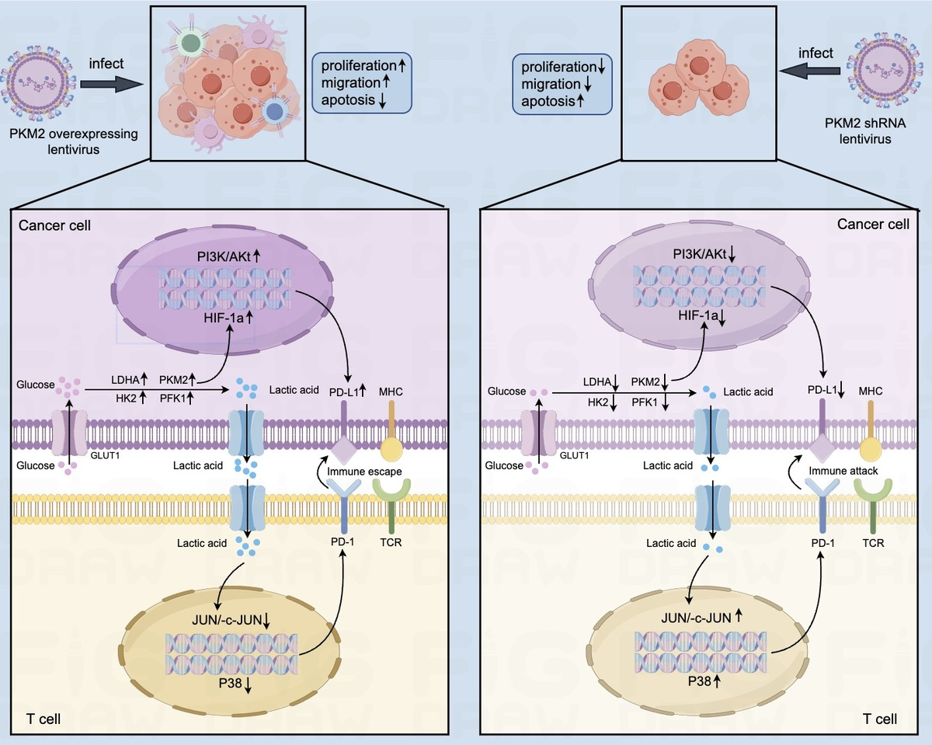

Pyruvate kinase M2 plays a pivotal role in promoting PD-L1 expression and malignant behaviors of hepatoma cells
DOI: 10.5114/aoms/208245
Notes:
Introduction
Pyruvate kinase M2 (PKM2) is a key rate-limiting enzyme that regulates glucose metabolic reprogramming (Warburg effect), but the correlation between PKM2 and PD-L1 or malignant behaviors in hepatocellular carcinoma (HCC) cells remains unknown. This study explored the role of PKM2 and the Warburg effect on the expression of PD-L1 and the malignant behaviors of HCC cells.
Material and methods
The relationship between the Warburg effect and key enzymes and signaling pathways was analyzed using bioinformatics; the expression of PD-L1, PKM2, and hexokinase 2 (HK2) in 30 patients’ HCC tissues and paired para-cancerous tissues was detected by immunohistochemistry and Western blotting. Short hairpin RNA (shRNA) silencing the expression of PKM2 was used to explore its influence on the expression of PD-L1 in HCC cells. The malignant behaviors of HCC cells were detected by scratch test, plate cloning experiment, Transwell migration experiment, and EdU staining; the concentrations of lactic acid, pyruvate, and ATP and the consumption of glucose were detected using a reagent kit.
Results
Biological information database and detection of HCC tissues and paired para-cancerous tissues showed that the expression levels of PKM2 and PD-L1 were significantly higher in HCC tissues than in paired para-cancerous tissues, and the expression of PKM2 was positively correlated with PD-L1 expression. PKM2 could promote the proliferation and migration of HCC cells, and stimulate the expression of PD-L1 through activating the PI3K/Akt signaling pathway in HCC cells.
Conclusions
PKM2 was able to upregulate the expression of PD-L1 and stimulate the malignant behaviors of HCC cells. Targeting PKM2 is a promising strategy for liver cancer treatment.

