Slide 1
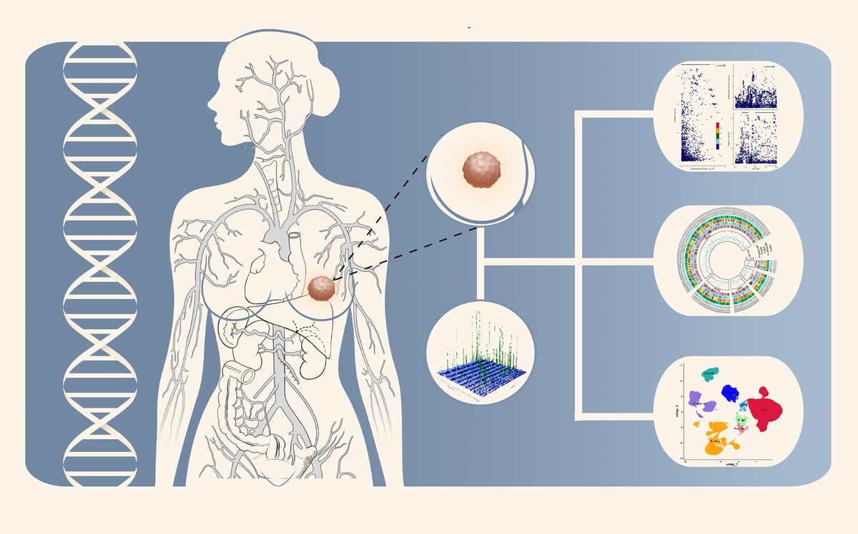

Plasma proteome–genome integration reveals novel protein biomarkers and therapeutic targets linked to breast cancer survival
DOI: 10.5114/aoms/208246
Arch Med Sci 2026;22(3):1678-1687
Notes:
Introduction
Identifying new drug targets is essential for improving breast cancer survival. The proteome provides a rich source for potential therapeutic targets. This study aimed to identify protein markers and therapeutic targets for breast cancer by using proteome-wide Mendelian randomization (MR).
Material and methods
Protein quantitative trait loci (pQTL) data were obtained from four large-scale proteomic studies, including 17,267 circulating protein markers. Genetic associations with breast cancer survival were derived from a large-scale GWAS meta-analysis (37,954 cases, 2,900 deaths). Proteome-wide MR was performed to estimate causal effects of proteins on breast cancer survival, complemented by single-cell expression analysis to identify enriched cell types. Protein-protein interactions (PPI) and druggability assessments were also conducted to prioritize therapeutic targets.
Results
Genetically predicted circulating levels of 27 proteins were found to be associated with breast cancer survival. Among these, eight proteins (ADAM15, CD83, SH3BGRL3, SNCG, ANXA1, GRHPR, ALDH2, and MTHFD2) showed the strongest evidence of association, while four proteins (ARG2, RPL14, NFU1, and TXNL4B) demonstrated a strong but slightly weaker correlation. Notably, SH3BGRL3, GRHPR, ARG2, RPL14, NFU1, and TXNL4B were newly identified as circulating protein markers significantly associated with breast cancer prognosis. Druggability analysis revealed that 13 of these proteins were already targeted by existing drugs, offering potential for breast cancer treatment.
Conclusions
We identified 27 genes encoding proteins associated with overall and subtype-specific breast cancer survival, providing potential prognostic biomarkers and therapeutic targets, and offering new avenues for improving breast cancer management.

