Slide 1
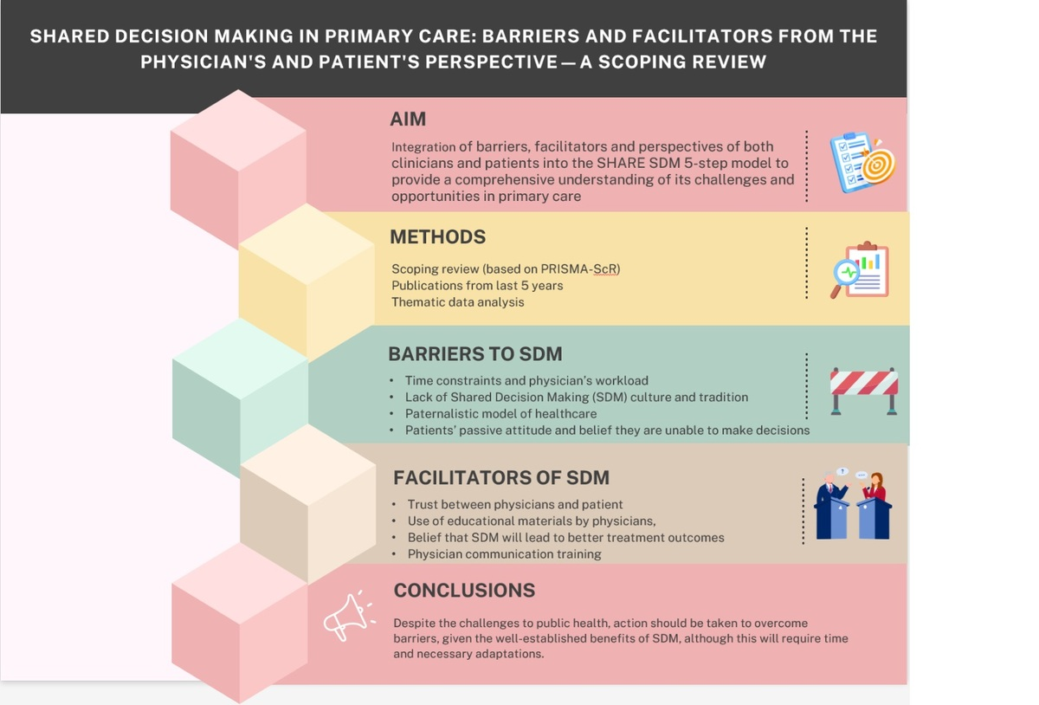

Shared decision-making in primary care: barriers and facilitators from the physician’s and patient’s perspectives: a scoping review
DOI: 10.5114/aoms/208300
Arch Med Sci 2026;22(3):1249-1258
Notes:
Introduction
Health-related communication and shared decision-making (SDM) are crucial elements of patient-centered care. The aim of this review was to identify the key barriers and facilitators influencing the adoption of an SDM approach from both the physician’s and patient’s perspectives in primary healthcare in relation to the 5-step model of SDM.
Material and methods
A scoping review of resources published within the last 5 years was conducted in June 2024 in accordance with PRISMA-ScR guidelines. Specific barriers hindering the adoption of SDM were identified, which can arise at any of the five steps.
Results
The most common barriers include: time constraints and physician’s workload, lack of SDM culture and tradition, paternalistic model of healthcare, and patients’ passive attitude and belief they are unable to make decisions. SDM facilitators include: trust, use of educational materials by physicians, belief that SDM will lead to better treatment outcomes, and training in communication for physicians.
Conclusions
Despite the challenges to public health, action should be taken to overcome these barriers, given the well-established benefits of SDM, although this will require time and necessary adaptations.

