Slide 1
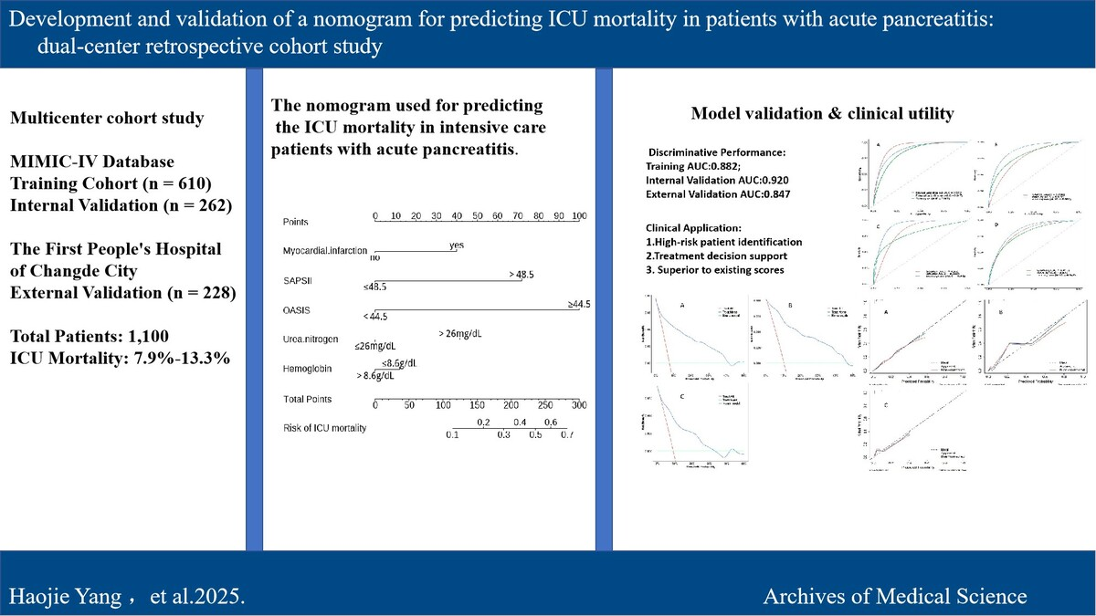

Development and validation of a nomogram for predicting ICU mortality in patients with acute pancreatitis: A dual-center retrospective cohort study.
DOI: 10.5114/aoms/208325
Notes:
Introduction
Acute pancreatitis(AP) is a severe inflammatory disease causing abdominal pain and organ failures, potentially leading to necrosis and dysfunction. This study aimed to create a nomogram to predict mortality in intensive care unit(ICU) patients with AP.
Material and methods
We conducted cohort study using the Medical Information Mart for Intensive Care IV(MIMIC-IV) and data from the first people’s hospital of Changde city, selecting variables via univariate logistic regression and constructing a nomogram with multivariate logistic regression. The nomogram's performance was evaluated with the area under the curve (AUC) calculated from the receiver operating curve (ROC), reclassification improvement (NRI) and integrated discrimination improvement (IDI), while clinical utility was assessed with a calibration curve and decision curve analysis (DCA) validated the predictive model's efficacy.
Results
A total of 1100 patients were analyzed, with ICU mortality rates of 7.9% in the training set, 9.2% in the internal validation set, and 13.3% in the external validation set. From the 32 extracted variables, five were ultimately selected: hemoglobin, urea nitrogen, SAPSII score, OASIS score, and myocardial infarction. We subsequently developed and validated a nomogram. The AUC, NRI, and IDI of the nomogram were superior to the traditional SAPSII and OASIS scoring systems. Calibration curves and the Hosmer-Lemeshow test revealed satisfactory alignment between predicted and observed outcomes, while DCA substantiated the clinical utility of the model across a wide range of threshold probabilities.
Conclusions
The nomogram accurately predicted ICU AP patients' mortality and may serve as a valuable tool for clinicians to identify high-risk patients and optimize medical decision-making.

