Slide 1
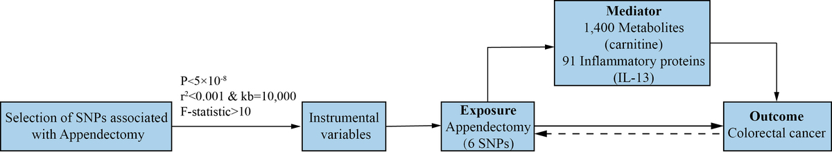

Dissecting the potential impact of appendectomy on colorectal cancer through metabolites and inflammatory proteins: a Mendelian randomization study
DOI: 10.5114/aoms/208360
Arch Med Sci 2026;22(4):2123-2132
Notes:
Introduction
Traditional longitudinal epidemiological investigations have demonstrated an association between appendectomy and the cumulative incidence of colorectal cancer (CRC). However, there is a paucity of evidence for a causal relationship between appendectomy and CRC from alternative methodologies.
Material and methods
We extracted summary statistics for CRC, appendectomy, 1,400 metabolites, and 91 inflammatory proteins from the largest European ancestry genome-wide association studies (GWAS) and the FinnGen study. Using two-sample bidirectional Mendelian randomization (MR), we explored the potential causal relationship between genetic liability to appendectomy and CRC. Moreover, we employed a two-step MR approach to identify metabolites and inflammatory proteins that may mediate the effects of genetic liability to appendectomy on CRC risk and analyzed their potential mediator variables. Furthermore, we used the significant single nucleotide polymorphisms (SNPs) associated with the risk of CRC due to appendectomy, searched for the nearest genes in the FinnGen, and explored the relationship between these genes and CRC prognosis by analyzing transcriptomic data from The Cancer Genome Atlas (TCGA) and Gene Expression Omnibus (GEO).
Results
Two-sample MR analysis revealed evidence supporting a potential causal effect of genetic liability to appendectomy on an increased risk of CRC. Two-step MR analysis identified carnitine and interleukin-13 (IL-13) as key mediators potentially involved in the positive causal relationship between genetic liability to appendectomy and CRC. Survival analysis showed that upregulation of HLX and OSR1 expression is positively correlated with poor prognosis in CRC patients.
Conclusions
This MR investigation provides evidence supporting a potential causal relationship between genetic liability to appendectomy and CRC, with carnitine and IL-13 potentially acting as partial mediators of this effect.

