Slide 1
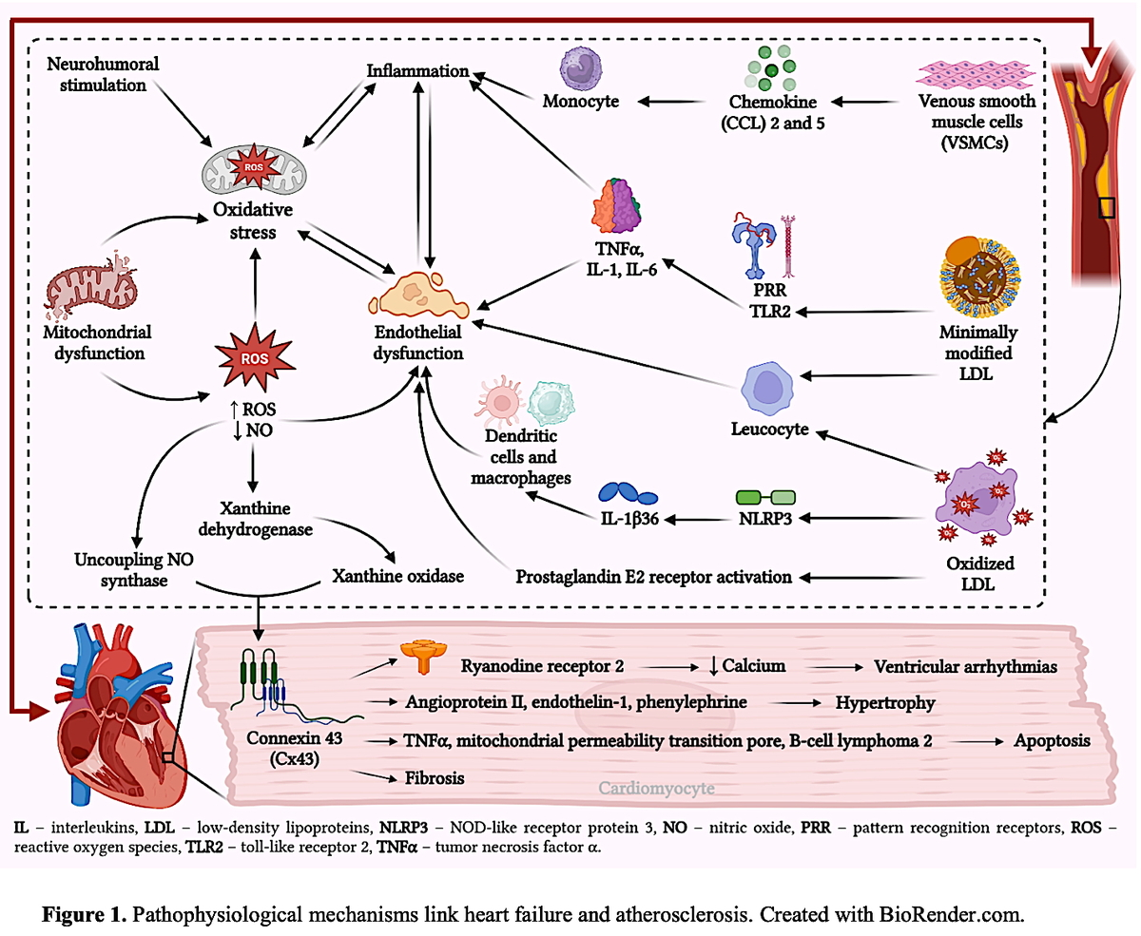

Atherosclerotic features in patients with heart failure
DOI: 10.5114/aoms/208372
Arch Med Sci 2025;21(4):1107-1129
Notes:
Heart failure (HF) and atherosclerosis represent two major cardiovascular diseases that are intricately linked, both contributing significantly to global morbidity, mortality, and healthcare burden. Despite substantial progress in diagnostic methods and therapeutic strategies, the overall impact of these conditions remains considerable. This is largely due to their complex and overlapping pathophysiological mechanisms, persistent residual atherosclerotic risk, and the ongoing challenges associated with implementing guideline-directed medical therapy for HF in routine clinical practice. Recent advancements in the management of diverse HF phenotypes, lipid abnormalities, atherosclerotic cardiovascular disease (ASCVD), and obesity have facilitated the adoption of multidrug regimens. These include β-blockers, renin-angiotensin-aldosterone system inhibitors, sodium-glucose cotransporter 2 (SGLT2) inhibitors, and glucagon-like peptide-1 (GLP-1), which have collectively improved outcomes in HF populations. Lipid-lowering therapy, particularly statins, has demonstrated significant efficacy in reducing ASCVD events and slowing HF progression, as well as lowering the risk of HF-related hospitalizations. Elevated lipoprotein(a) [Lp(a)] has emerged as an independent risk factor for both ASCVD and HF, being associated with increased risk of incident HF, disease progression, hospitalization, and adverse outcomes. However, there remains a lack of conclusive evidence as to whether targeted reduction of Lp(a) leads to a decrease in major adverse cardiovascular events or improves HF incidence or outcomes. In parallel, contemporary therapeutic advances in coronary and peripheral artery revascularization, along with novel pharmacologic treatments for obesity such as GLP-1 receptor agonists including semaglutide and tirzepatide have shown beneficial effects in reducing cardiovascular mortality, HF progression, and body weight, irrespective of HF status. These converging therapeutic strategies underscore the close interrelationship between HF and atherosclerosis. This review aims to elucidate the shared pathophysiological mechanisms linking these conditions and to examine their clinical overlap with ischemic heart disease, cerebrovascular disease, peripheral arterial disease, dyslipidemia, and obesity. A comprehensive understanding of these interrelated cardiovascular entities may offer valuable insights to inform future research directions and optimize the clinical management of patients affected by both HF and atherosclerotic disease.

