Slide 1
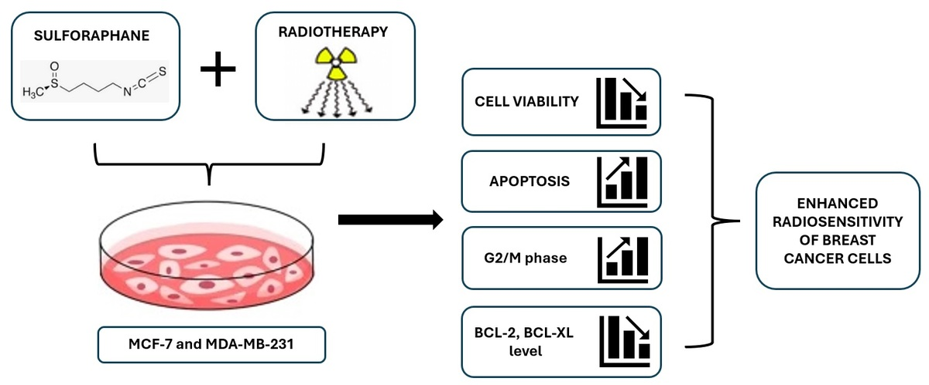

The effectiveness of sulforaphane in radiosensitizing breast cancer cells
DOI: 10.5114/aoms/208378
Arch Med Sci 2026;22(4):2379-2388
Notes:
Introduction
Radiotherapy is a vital therapeutic option in the treatment of breast cancer nowadays. However, a major obstacle to the full effectiveness of radiation therapy is still the radioresistance of cancer cells. Various studies have proven sulforaphane’s (SFN) beneficial effects against cancer and its possible utilization as a radiosensitizer in radiotherapy. This study aimed to investigate whether SFN has a radiosensitizing effect on breast cancer cells.
Material and methods
The anticancer efficiency of SFN and radiosensitizing effect in MCF-7 and MDA-MB-231 cell lines were assessed by the MTT assay. Using a flow cytometric assay, the apoptosis level and changes in the cell cycle were measured. RT-qPCR and Western blot analysis were used to determine the expression and protein levels of the BCL-2 and BCL-XL genes.
Results
According to our results, SFN reduced the viability of cells, and combining SFN with radiation therapy (IR) caused much greater anticancer effects on cells. SFN + IR was shown to enhance the number of cells in the G2/M phase and the percentage of cells undergoing apoptosis. SFN reduced the expression of the apoptosis-related genes BCL-2 and BCL-XL. Consistent with these data, Western blot analysis revealed that BCL-2 and BCL-XL protein levels were decreased in tested cells. As a result of the combination treatment, downregulation of the BCL-2 protein was observed only in MDA-MB-231 cells.
Conclusions
These results indicate that SFN acts as a radiosensitizer by enhancing apoptotic cell death and reducing anti-apoptotic gene expression in breast cancer cells.

