Slide 1
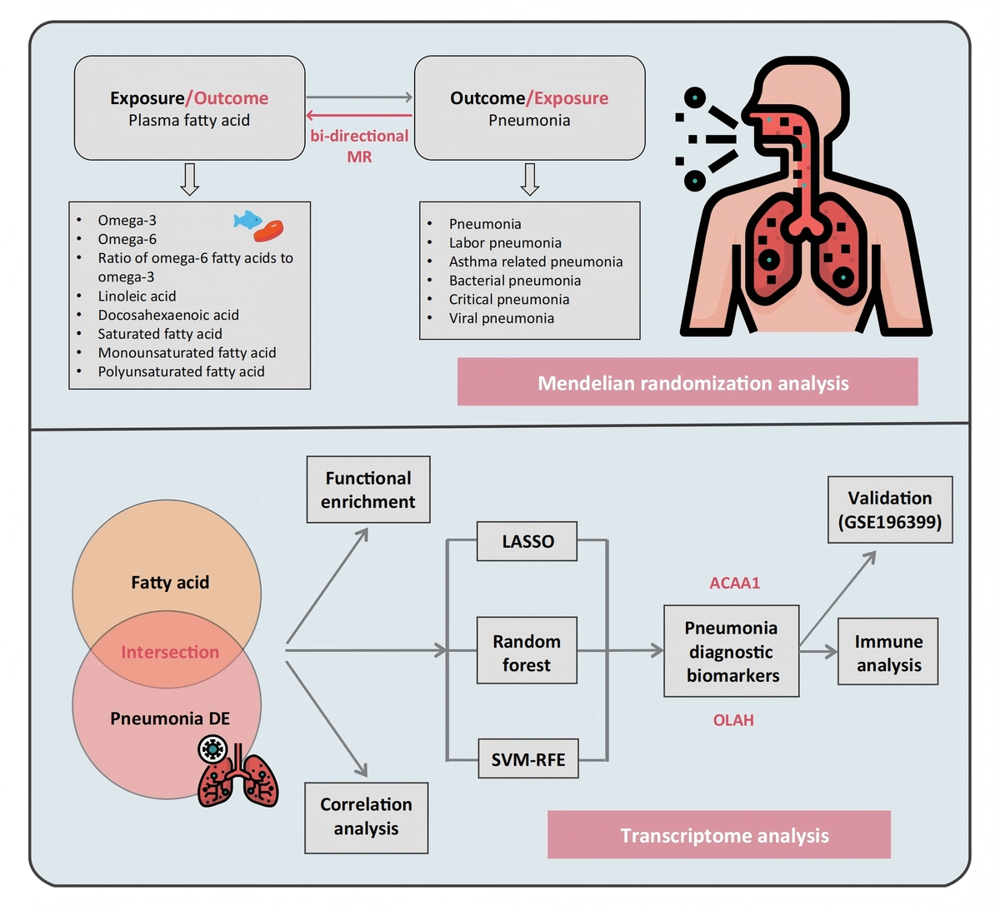

Causal analysis of plasma fatty acids and pneumonia: identifying diagnostic biomarkers through transcriptome-wide association study
DOI: 10.5114/aoms/208380
Notes:
Introduction
Fatty acids mediate pulmonary inflammation through cytokine regulation, interactions with the tryptophan-kynurenine pathway, and mediators such as 18-HEPE that boost interferon-λ. To systematically dissect these mechanisms and their translational implications, we pioneered a novel framework integrating bidirectional two-sample Mendelian randomization (MR) with multi-algorithm machine learning. This approach not only quantifies causal relationships between fatty acids and inflammatory outcomes but also identifies clinically actionable diagnostic biomarkers.
Material and methods
We obtained single nucleotide polymorphisms (SNPs) significantly associated with eight plasma fatty acids from genome-wide association study (GWAS) summary statistics and used them as instrumental variables in bidirectional two-sample MR across six pneumonia phenotypes (pneumonia, asthma-related pneumonia, bacterial pneumonia, critical pneumonia, viral pneumonia, and lobar pneumonia). Causal estimates were calculated using inverse variance weighting (IVW), which combines SNP-specific Wald ratios weighted by the inverse of their variance, with MR-Egger and weighted median approaches for sensitivity analysis. Transcriptomic data were then analyzed by LASSO regression, support vector machine recursive feature elimination and random forest to identify fatty acid metabolism–related biomarker candidates.
Results
MR analysis suggested potential causal associations between omega-6 fatty acids and critical pneumonia (OR = 1.28, 95% CI: 1.01–1.61, p = 0.038), linoleic acids (LA) and bacterial pneumonia (OR = 0.85, 95% CI: 0.73–0.99, p = 0.047), and docosahexaenoic fatty acids (DHA) and pneumonia (OR = 0.83, 95% CI: 0.74–0.93, p = 0.002). Moreover, ACAA1 and OLAH, which are genes involved in fatty acid metabolism, were identified as potential candidate biomarkers for pneumonia.
Conclusions
Our study employed MR analysis to establish a causal association of omega-6, LA, and DHA with pneumonia. Additionally, through transcriptomic analysis, we identified plasma fatty acid metabolism-associated biomarkers that may serve as diagnostic indicators for pneumonia.

