Slide 1
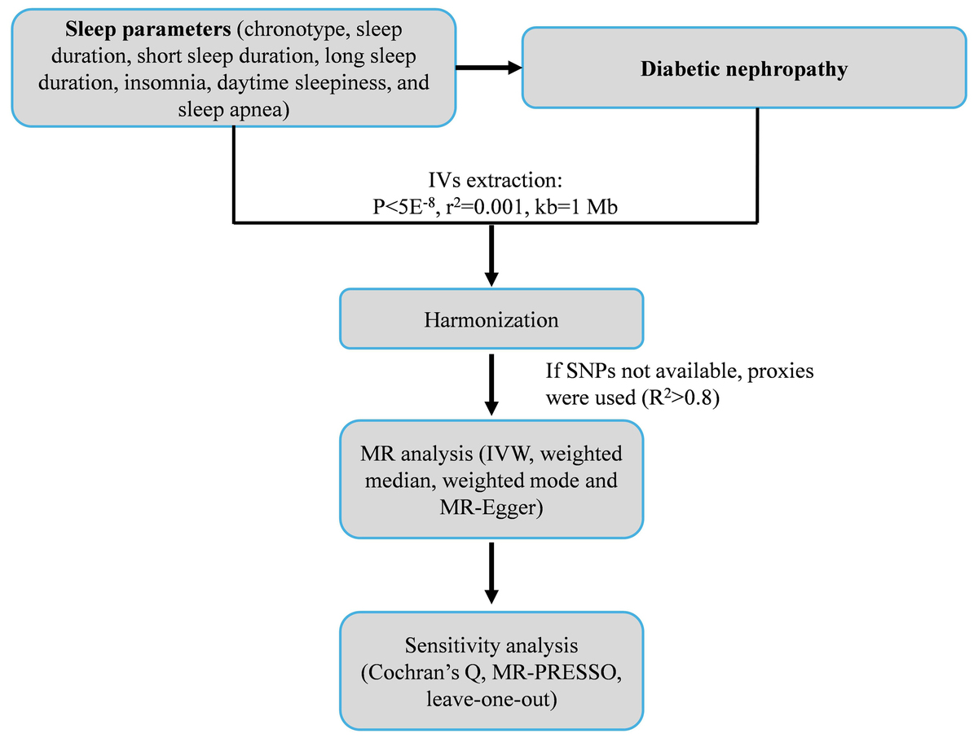

Causal association between sleep traits and diabetic nephropathy
DOI: 10.5114/aoms/208530
Arch Med Sci 2025;21(6):2493-2501
Notes:
Introduction
The study aimed to explore the causal association between genetically predicted sleep traits (chronotype, sleep duration, short sleep duration, long sleep duration, insomnia, daytime sleepiness, and sleep apnea syndrome) and diabetic nephropathy (DN).
Material and methods
A two-sample Mendelian randomization (MR) design was used to analyze summary data from genome-wide association studies of sleep traits and DN. The main analysis was conducted using the inverse variance weighted (IVW) method, and robustness was tested using the weighted median, weighted mode, and MR-Egger regression methods. Heterogeneity was detected using Cochran’s Q-test, horizontal pleiotropy using the MR-Egger regression method, potential outliers using MR-PRESSO, and single-nucleotide polymorphisms driving the results using a leave-one-out analysis.
Results
The genetic prediction results indicated no statistically significant associations between the sleep traits and DN (all IVW p > 0.05). However, the weighted median analysis showed a possible causal association between long sleep and DN (OR < 0.01, 95% CI: 0–0.70, p = 0.04) and a borderline possible causal association between sleep apnea syndrome and DN (OR = 2.50, 95% CI: 0.99–6.35, p = 0.05). Cochran’s Q-test indicated possible heterogeneity for the sleep duration analysis (p = 0.01), but no horizontal pleiotropy or outliers were detected (all p > 0.05).
Conclusions
This MR analysis suggested no causal associations between the sleep traits (chronotype, sleep duration, short sleep duration, long sleep duration, insomnia, daytime sleepiness, and sleep apnea syndrome) and DN. Further in-depth research is needed to examine the relationship between sleep and DN.

