Slide 1
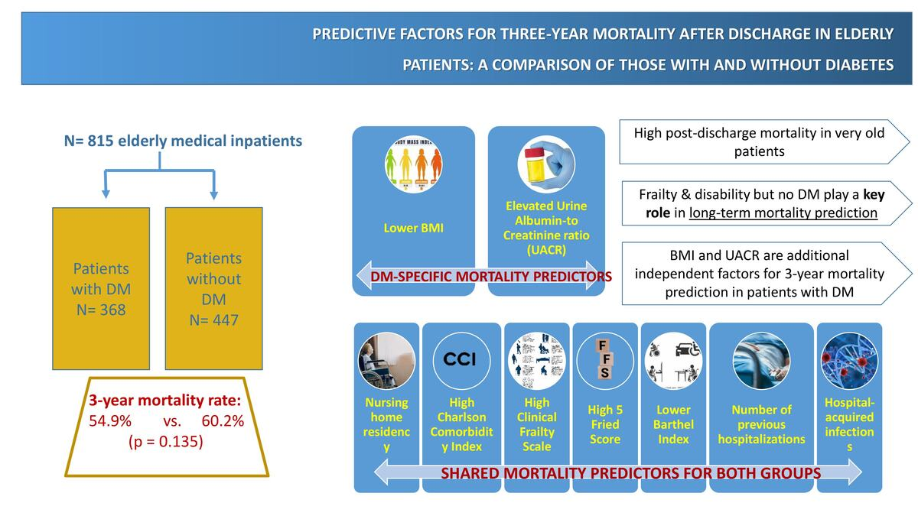

Predictive factors for three-year mortality after discharge in elderly patients: a comparison of those with and without diabetes
DOI: 10.5114/aoms/208591
Arch Med Sci 2025;21(5):1783-1791
Notes:
Introduction
Diabetes mellitus (DM) is associated with increased mortality in hospitalized adults. However, data regarding the impact of DM on long-term mortality after discharge in very old patients are scarce. This prospective study assessed 3-year post-discharge mortality and its predictive factors in older patients, focusing on possible differences between patients with and without DM.
Material and methods
Medical history, chronic medication use, clinical and laboratory characteristics, Charlson Comorbidity Index (CCI), 5-item Fried Frailty Score (FFS), Clinical Frailty Scale (CFS), Barthel Index (BI), and Katz Index were recorded on admission.
Results
A total of 815 older adults (46.0% males) with a median age of 83.0 years (IQR: 77.0–88.0) were included in the study. The 3-year mortality rate was 54.9% in patients with DM (n = 368) and 60.2% in patients without DM (n = 447, p = 0.13 between groups). In multivariate logistic analysis, nursing home residency, higher CCI, higher CFS, higher FFS, lower BI, the total number of days of hospitalization in the past year, and hospital-acquired infections were independently associated with the 3-year mortality in both groups. In individuals with DM, lower body mass index (BMI) and elevated urine albumin-to-creatinine ratio (UACR) were identified as additional independent predictors of 3-year mortality.
Conclusions
A high post-discharge mortality rate was observed in very old patients. DM was not identified as an independent factor of post-discharge mortality. Assessment of frailty and disability in very old patients is important for predicting long-term post-discharge mortality. Additionally, in patients with DM, evaluating BMI and UACR may aid in better prediction of 3-year mortality.

