Slide 1
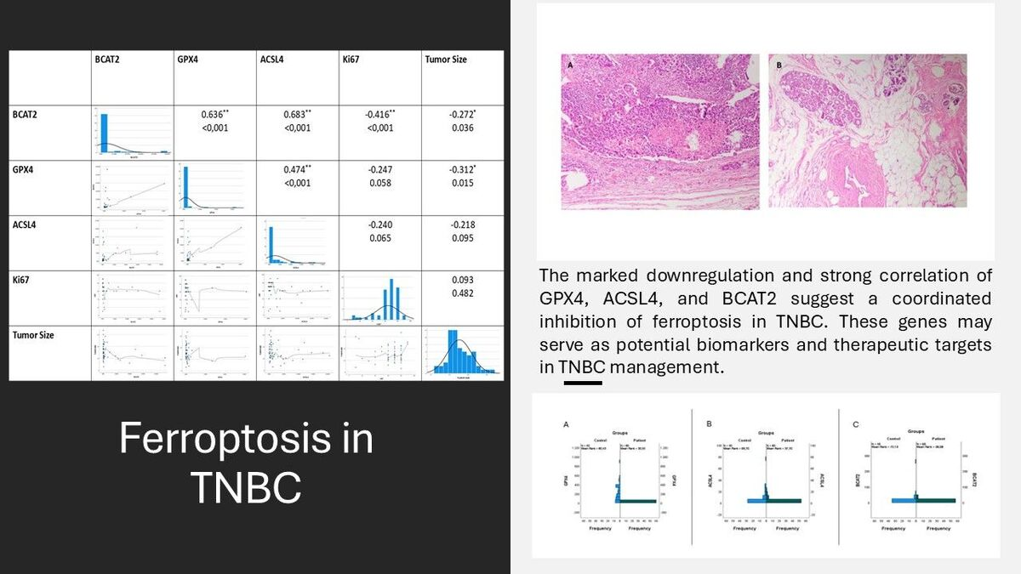

Triple-negative breast cancer and ferroptosis: expression profiling of key regulatory genes
DOI: 10.5114/aoms/208615
Arch Med Sci 2025;21(5):2079-2087
Notes:
Introduction
Triple-negative breast cancer (TNBC) is an aggressive subtype of breast cancer characterized by the absence of estrogen receptor (ER), progesterone receptor (PR), and human epidermal growth factor receptor 2 (HER2). Ferroptosis, a regulated form of cell death driven by lipid peroxidation, has emerged as a potential therapeutic target. This study aimed to evaluate the expression levels of ferroptosis-associated genes GPX4, ACSL4, and BCAT2 in TNBC tissues and to investigate their potential as diagnostic or therapeutic biomarkers.
Material and methods
A total of 100 formalin-fixed paraffin-embedded (FFPE) breast tissue samples were analyzed, including 60 TNBC patient samples and 40 healthy controls. Gene expression levels of GPX4, ACSL4, and BCAT2 were determined using RT-qPCR. Statistical comparisons were conducted using the Mann-Whitney U test, and correlation analyses were performed using Spearman’s test.
Results
The expression levels of GPX4, ACSL4, and BCAT2 were significantly lower in the TNBC group compared to controls (p = 0.0001 for all genes). Strong positive correlations were observed among the three genes, with BCAT2 showing the highest correlation with both GPX4 (R = 0.636) and ACSL4 (R = 0.683). Additionally, BCAT2 expression negatively correlated with tumor diameter and Ki-67 index.
Conclusions
The significant downregulation and strong positive correlation of GPX4, ACSL4, and BCAT2 in TNBC tissues suggest coordinated suppression of ferroptosis. These findings highlight the potential of targeting ferroptosis as a novel therapeutic strategy in TNBC and propose these genes as candidate biomarkers for diagnosis and treatment response.

