Slide 1
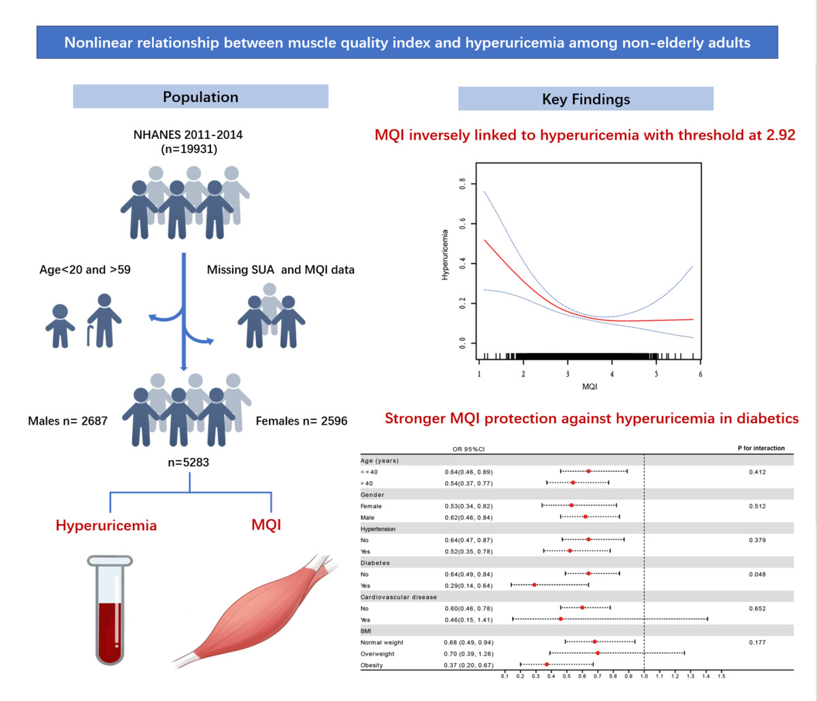

Nonlinear relationship between muscle quality index and hyperuricemia among non-elderly adults
DOI: 10.5114/aoms/208850
Notes:
Introduction
The muscle quality index (MQI) is an increasingly recognized indicator of muscle status. The objective of this research was to analyze the association between MQI and hyperuricemia.
Material and methods
We performed a cross-sectional analysis using data from the National Health and Nutrition Examination Survey (NHANES) spanning the years 2011 to 2014. Participants in this study were adults aged 20–59 years. The muscle quality index (MQI) was calculated as the ratio of handgrip strength (HGS) to appendicular skeletal muscle mass (ASM). Hyperuricemia was defined by serum uric acid concentrations exceeding 420 µmol/l (7 mg/dl) in males and 360 µmol/l (6 mg/dl) in females. Assessment of the MQI-hyperuricemia relationship involved logistic regression, analysis of subgroups, and the application of smooth curve fitting.
Results
This research included 5,283 participants, of whom 716 had hyperuricemia. The prevalence of hyperuricemia decreased with higher quartiles of MQI (p < 0.001). After correcting for confounders, MQI was closely associated with hyperuricemia (OR = 0.59, 95% CI: 0.46–0.77, p < 0.001). Smooth curve fitting indicated a nonlinear association between the variables, with a threshold identified at 2.92. Subgroup analyses demonstrated that this association was particularly evident in participants with diabetes.
Conclusions
Our findings revealed an inverse correlation between MQI and hyperuricemia, suggesting that preserving adequate muscle quality may be advantageous in reducing the risk of hyperuricemia. Further prospective research is needed.

