Slide 1
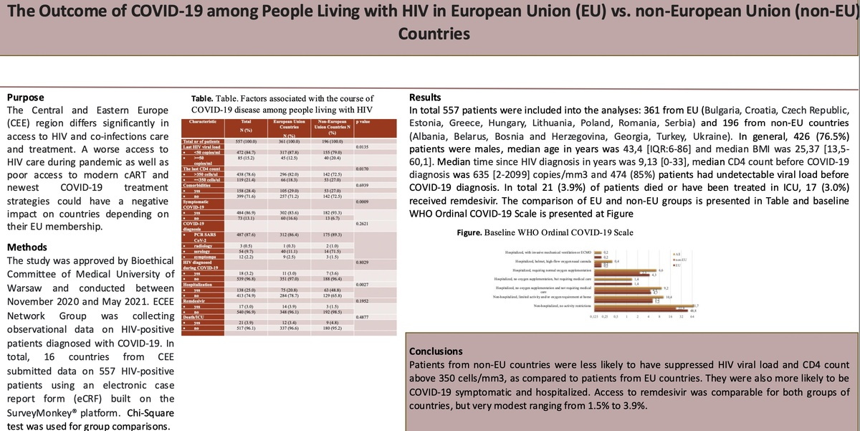

The Outcome of Coronavirus Disease 2019 among People Living with HIV in European Union versus Non-European Union Countries
DOI: 10.5114/aoms/208856
Notes:
Introduction
The Central and Eastern Europe (CEE) region differs in access to HIV and co-infections care and treatment. The aim of the study was to analyze the relation between the severity of the COVID-19 disease and HIV specific factors in the European Union (EU) Countries and in non-European Union (non-EU) Countries.
Material and methods
The study was conducted between November 2020 and May 2021. Euroguidelines in Central and Eastern Europe (ECEE) Network Group was collecting observational data on HIV-positive patients diagnosed with COVID-19. In total, 16 countries from CEE (Poland, Czech Republic, Ukraine, Croatia, Turkey, Romania, Belarus, Estonia, Lithuania, Greece, Georgia, Albania, Hungary, Serbia, Bosnia and Herzegovina, and Bulgaria) submitted data on HIV-positive patients using an electronic case report form (eCRF). Chi-Square test was used for group comparisons.
Results
In total 557 patients were included into the analyses: 361 from EU and 196 from non-EU countries. Access to remdesivir was 1.5% in non-EU countries vs 3.9% in EU-countries (p= 0.1952) . Symptoms of COVID-19 occurred more often in non-EU countries (93.3%) vs non-EU countries (83.6%) [p=0.0009], as well as hospitalization 32.8% vs. 20.8% respectively [0.0027]. Death/ICU was 4.8% in non-EU countries vs 3.4% in EU-countries (p=0.4877). In total 18 (3.23%) patients found out about HIV diagnosis during COVID-19, which was comparable in two groups (11 [3.0%] in UE countries vs. 7 [3.6%] in non-UE countries; p=0.8029).
Conclusions
Patients from non- EU countries were more likely to be COVID-19 symptomatic and hospitalized. Access to antiviral therapy for SARS-CoV-2 was very low for all CEE countries.

