Slide 1
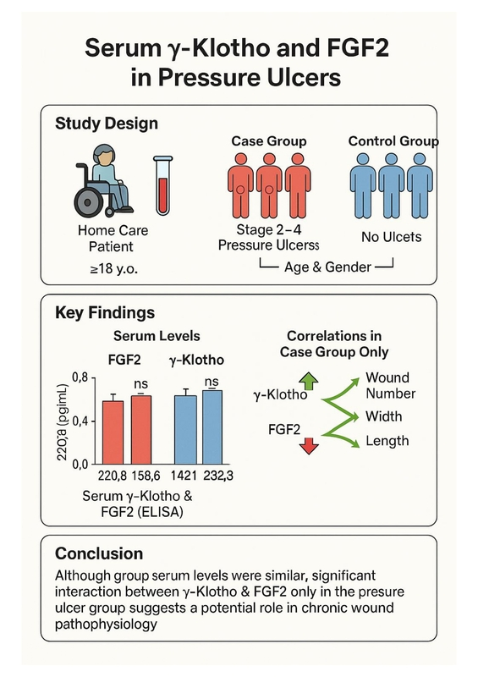

Serum γ-Klotho and fibroblast growth factor-2 levels in patients with pressure ulcers
DOI: 10.5114/aoms/208918
Arch Med Sci 2026;22(4):2211-2219
Notes:
Introduction
This study aimed to evaluate the serum levels of γ-Klotho and fibroblast growth factor 2 (FGF2) in patients with pressure ulcers.
Material and methods
Patients aged ≥ 18 years receiving care from Home Health Care Services were included. The case group consisted of individuals with stage 2–4 pressure ulcers, while the control group comprised patients without ulcers, matched for age and sex. Sociodemographic characteristics, medical device usage, and nutritional status were assessed for all participants. In the case group, additional data regarding ulcer site, stage, number, and dimensions were collected. Serum levels of γ-Klotho and FGF2 were measured using ELISA.
Results
A total of 80 participants were enrolled (40 (50.0%) in each group). The median FGF2 level was 220.8 [IQR 26.8] pg/ml in the case group and 219.1 [29.1] pg/ml in the control group (p = 0.577). Similarly, the median γ-Klotho level was 1448.4 [158.6] pg/ml in the case group and 1421.3 [232.8] pg/ml in the control group (p = 0.453). Additionally, a significant correlation was observed between γ-Klotho and FGF2 levels in the case group (p = 0.048), whereas no such association was found in the control group (p = 0.164). Furthermore, FGF2 levels were positively associated with the number, width, and length of the wounds (p = 0.003, p = 0.007, and p = 0.012, respectively), while a negative correlation was observed between γ-Klotho levels and wound duration (p = 0.026).
Conclusions
Although serum levels did not differ between groups, the exclusive correlation between γ-Klotho and FGF2 in the pressure ulcer group suggests a potential association with chronic wound characteristics, warranting further investigation.

