Slide 1
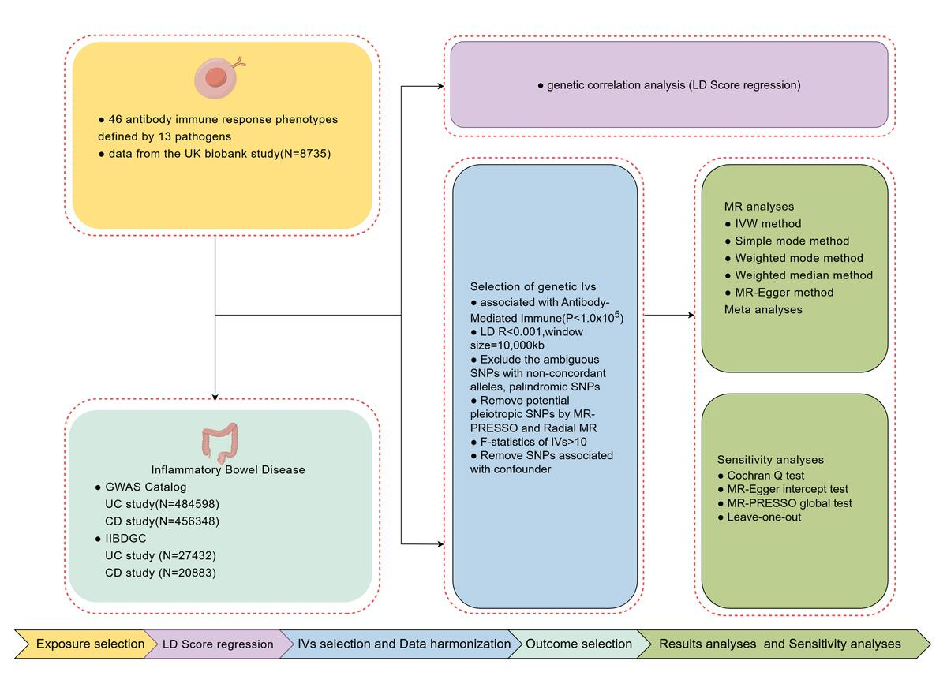

Antibody-mediated immune responses and inflammatory bowel disease: insights from genetic correlation and Mendelian randomization
DOI: 10.5114/aoms/208921
Arch Med Sci 2026;22(4):2353-2362
Notes:
Introduction
Observational studies suggest a complex relationship between infectious diseases and inflammatory bowel disease (IBD), yet the underlying mechanisms remain unclear. This study examined the genetic correlations and causal associations between antibody-mediated immune responses (targeting 46 infectious pathogens) and IBD, using linkage disequilibrium score regression (LDSC) and Mendelian randomization (MR) to inform early prevention and personalized treatment.
Material and methods
Data from the UK Biobank (8,735 samples) were used to identify independent SNPs associated with antibody responses. IBD-related data from the GWAS Catalog included 2,515 ulcerative colitis (UC) cases and 482,083 controls, as well as 1,342 Crohn’s disease (CD) cases and 455,006 controls. Validation was done using datasets from the International IBD Genetics Consortium (IIBDGC), including 6,968 UC and 5,956 CD cases. Genetic correlations were assessed using LDSC, and causal links were investigated through MR analysis, employing inverse-variance weighting (IVW) and sensitivity analyses.
Results
Genetic correlations were found between antibody responses to specific pathogens and IBD. MR analysis revealed causal effects of antibody responses to four pathogens on UC and protective/risk effects on CD. No horizontal pleiotropy or heterogeneity was observed, and sensitivity analyses confirmed the consistency of the findings.
Conclusions
This study provides genetic evidence for causal associations between antibody-mediated immune responses to 46 pathogens and IBD in European populations, offering insights into IBD pathogenesis and implications for prevention and treatment strategies.

